Slide 1





Application Progress
Innovative Fulfillment Solutions
that do more
  Ken Burkett RPh.,MBA
  William Graves MBA
  Riaz Ahmad
  CEO & Technology Officer
  VP Operations
  Project Manager
Provisional Patent Documentation started Oct 3 2015

Slide 2
OUT OF POCKET COSTS
Generic drug prices have doubled in cost to patients since 2014 ¹
86% (3.5 Billion) of all prescriptions (2014) were filled with generics ¹
Americans surveyed are paying $39 more per month for maintenance medications vs. 2014 ¹
To save money on their prescription drugs 24% stopped filling, 7% shopped out of country; another 16% skipped doses ²
¹ “Consumer Reports accessed online: http://www.consumerreports.org/cro/news/2016/08/are-you-paying-more-for-your-meds/index.htm
² 2012 State of the States: Adherence Report.” CVSCaremark Health Woonsocket, RI access March 2015

Slide 3
PROGRAM THEMES
Pharmacy Agnostic, scalable Network
Supports rapid deploy of heterogeneous pharmacies into a single network
Claim Accountability & Transparency
Manage Rx burden, same day fills, detailed transaction logs, app based payment
Convenience --Bring pharmacy to the patient
flexible delivery options
Profitable Rx’s based on Insurance reimbursement
$0 Drug List™ formulary where each Rx filled by the pharmacy is 38% profit/rx ($12.80)
Lower cost Rx’s through maximizing operational efficiencies
No Paper- all electronic
Mfr Direct pricing
Application populates demographics & payment card
Patients earn rewards; lowers out of pocket by $3-15 per Rx

Slide 4
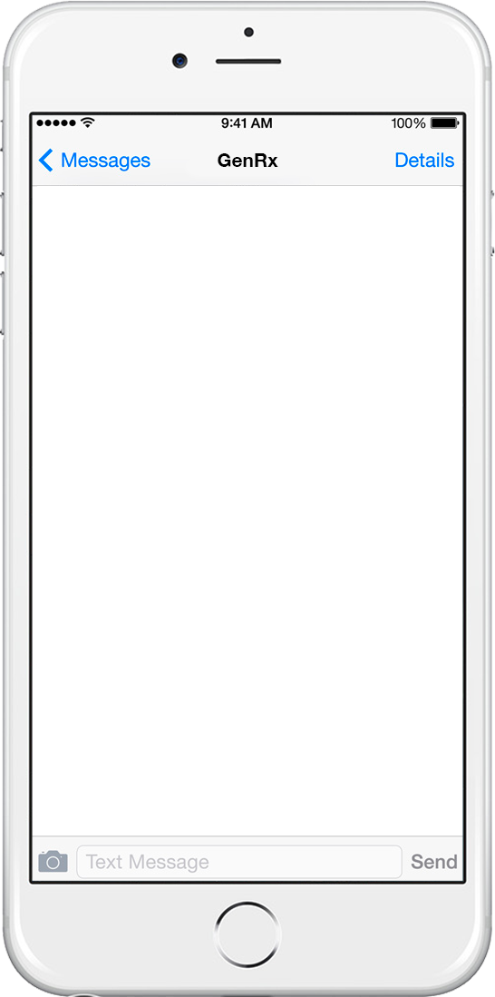

New to DFW – RX-DIRECT HOME DELIVERY Pharmacy - now delivers as fast as same day. Get Pay as little as $0 per 90 days' supply for some generics!
Promotional Outreach 1
Using the RxDirect mobile APP makes transferring your Rx as easy as snapping a pic or 6 second video of your current Rx label. We handle the rest!
simply reply “1” to request the get the GenericDirect app Text STOP to end
Tired of the Pharmacy. Pay less. Stop waiting.
Known opt in patients
1
Fantastic! Here’s the link This is where the link is provided
Registration process takes about 5 mins and you’ll receive $5.00 towards each generic purchase
© 2016. Prepared for internal use only. This document contains information proprietary and confidential to Ingenious Mobility Ventures (IMV) and is not to be disclosed in whole or in part without the express written consent of IMV

Slide 5
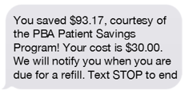
Tired of waiting at the Pharmacy? RX-DIRECT DFW accepts your insurance & can deliver to you same or next business day. Receive $5 off each Rx copay.
Promotional Outreach 2
For DFW residents only- we make transfer of your generic Rx’s easy using our app for GenericRx Direct. We handle the rest Reply 1 to get for iOS; 2 for Android
1
Known opt in patients
Fantastic! Here’s the link This is where the link is provided
Registration process takes about 5 mins and you’ll receive $5.00 towards each generic purchase
© 2016. Prepared for internal use only. This document contains information proprietary and confidential to Ingenious Mobility Ventures (IMV) and is not to be disclosed in whole or in part without the express written consent of IMV

Slide 6
Tired of the retail Pharmacy? Pay less. Stop waiting. Rx-Direct Dallas delivers to you same or next business day. Receive $5 off each of your generic Rx copay
Promotional Outreach 3
For DFW residents only- we make transfer of your generic Rx’s easy using our app for GenericRx Direct. We handle the rest Reply 1 to get for iOS; 2 for Android
1
Known opt in patients
Fantastic! Here’s the link This is where the link is provided
Registration process takes about 5 mins and you’ll receive $5.00 towards each generic purchase
© 2016. Prepared for internal use only. This document contains information proprietary and confidential to Ingenious Mobility Ventures (IMV) and is not to be disclosed in whole or in part without the express written consent of IMV

Slide 7
Pay less. Stop waiting. Accepts your insurance. Rx-Direct Dallas delivers to you same or next business day. Receive $5 off each of your generic Rx copay
Promotional Outreach 4
For DFW residents only- we make transfer of your generic Rx’s easy using our app for GenericRx Direct. We handle the rest Reply 1 to get for iOS; 2 for Android
1
Known opt in patients
Fantastic! Here’s the link This is where the link is provided
Registration process takes about 5 mins and you’ll receive $5.00 towards each generic purchase
© 2016. Prepared for internal use only. This document contains information proprietary and confidential to Ingenious Mobility Ventures (IMV) and is not to be disclosed in whole or in part without the express written consent of IMV

Slide 8
Every Rx costs less – We also accept your Insurance. No waiting Rx-Direct DFW delivers to you same or next business day. Receive $5 off each of your generic Rx copay
Promotional Outreach 5
For DFW residents only- we make transfer of your Rx’s easy using our app for GenericRx Direct. We handle the rest Reply 1 to get for iOS; 2 for Android
1
Known opt in patients
Fantastic! Here’s the link This is where the link is provided
Registration process takes about 5 mins and you’ll receive $5.00 towards each generic purchase
© 2016. Prepared for internal use only. This document contains information proprietary and confidential to Ingenious Mobility Ventures (IMV) and is not to be disclosed in whole or in part without the express written consent of IMV

Slide 9

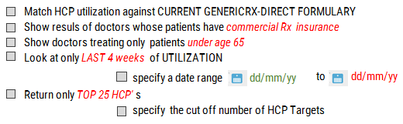

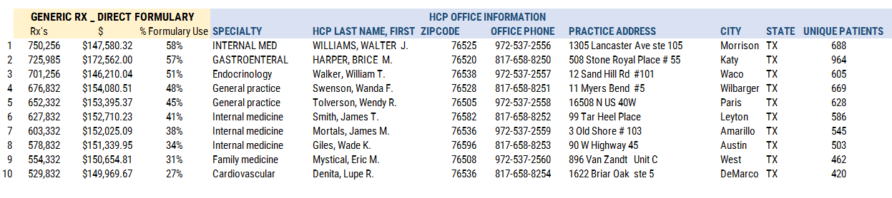
HCP TARGETS
Settings
TARGET
REGION
7 6 5
12/01/15
12/09/15
10
zip code
___
SUBMIT
© 2016. Prepared for internal use only. This document contains information proprietary and confidential to Ingenious Mobility and is not to be disclosed in whole or in part without the express written consent of IMV.

Slide 10
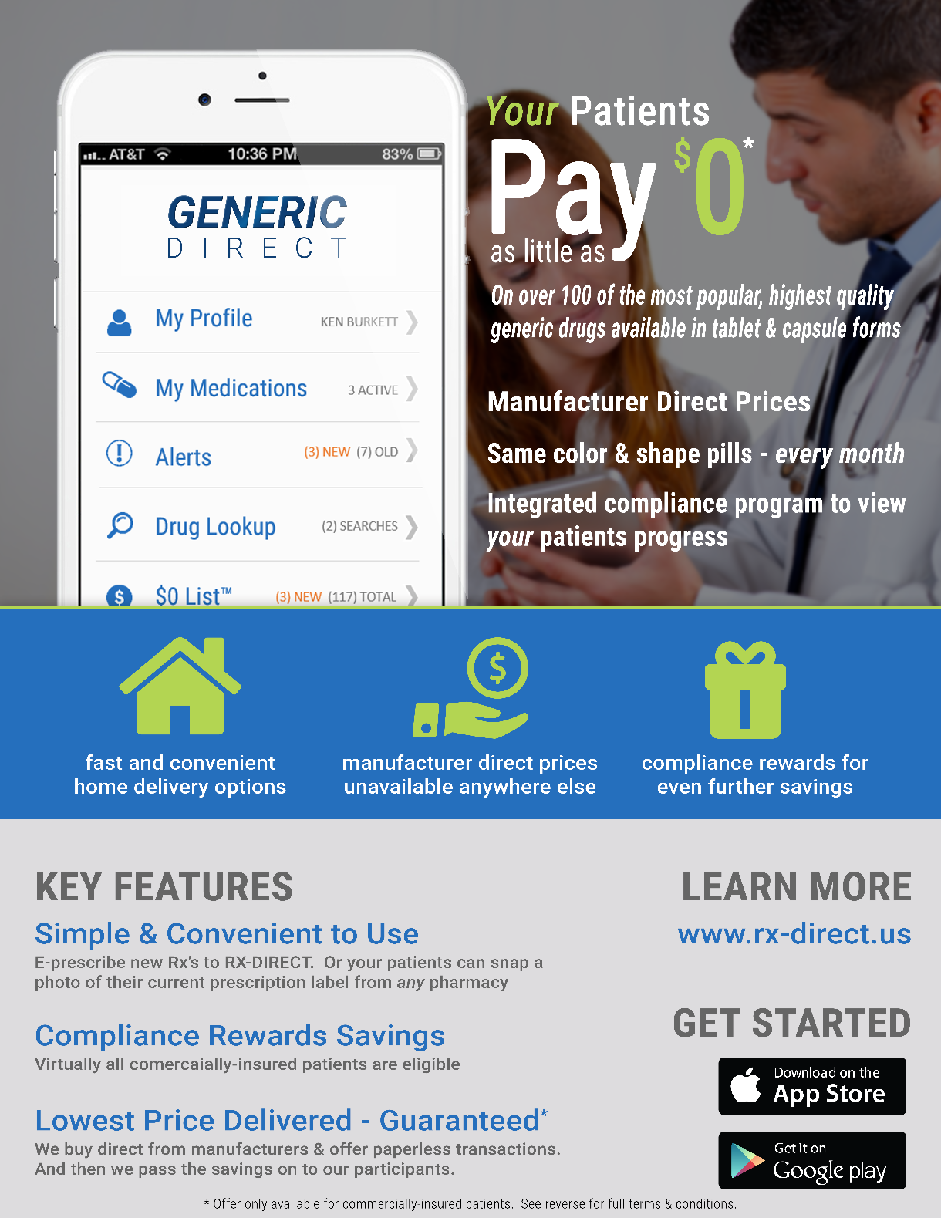
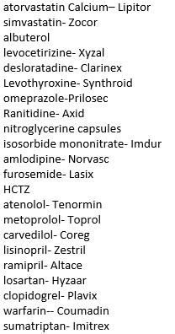
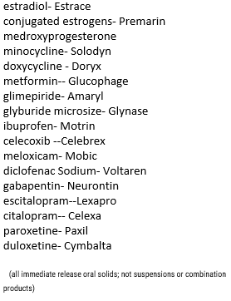
Office LEAVE BEHIND
AB rated, FDA approved generic Oral Solids
No C-II Drugs
Highly Utilized Products
Low cost Acquisition & Handling Fee
Direct-Rx DirectRx.com GENERICRx-Direct GenericRx-direct.com RX-DIRECT www.Rx-Direct.us
© 2016. Prepared for internal use only. This document contains information proprietary and confidential to Ingenious Mobility and is not to be disclosed in whole or in part without the express written consent of IMV.

Slide 11
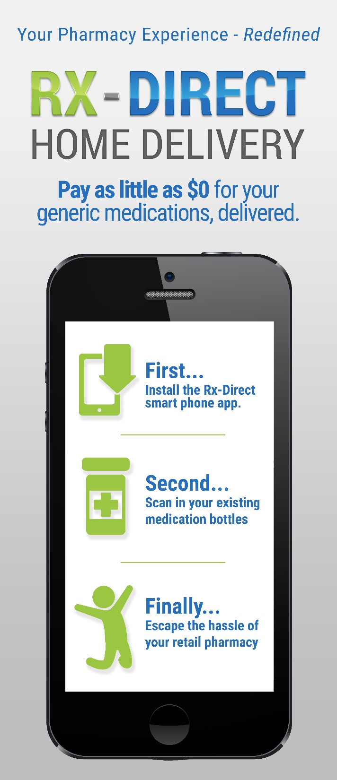
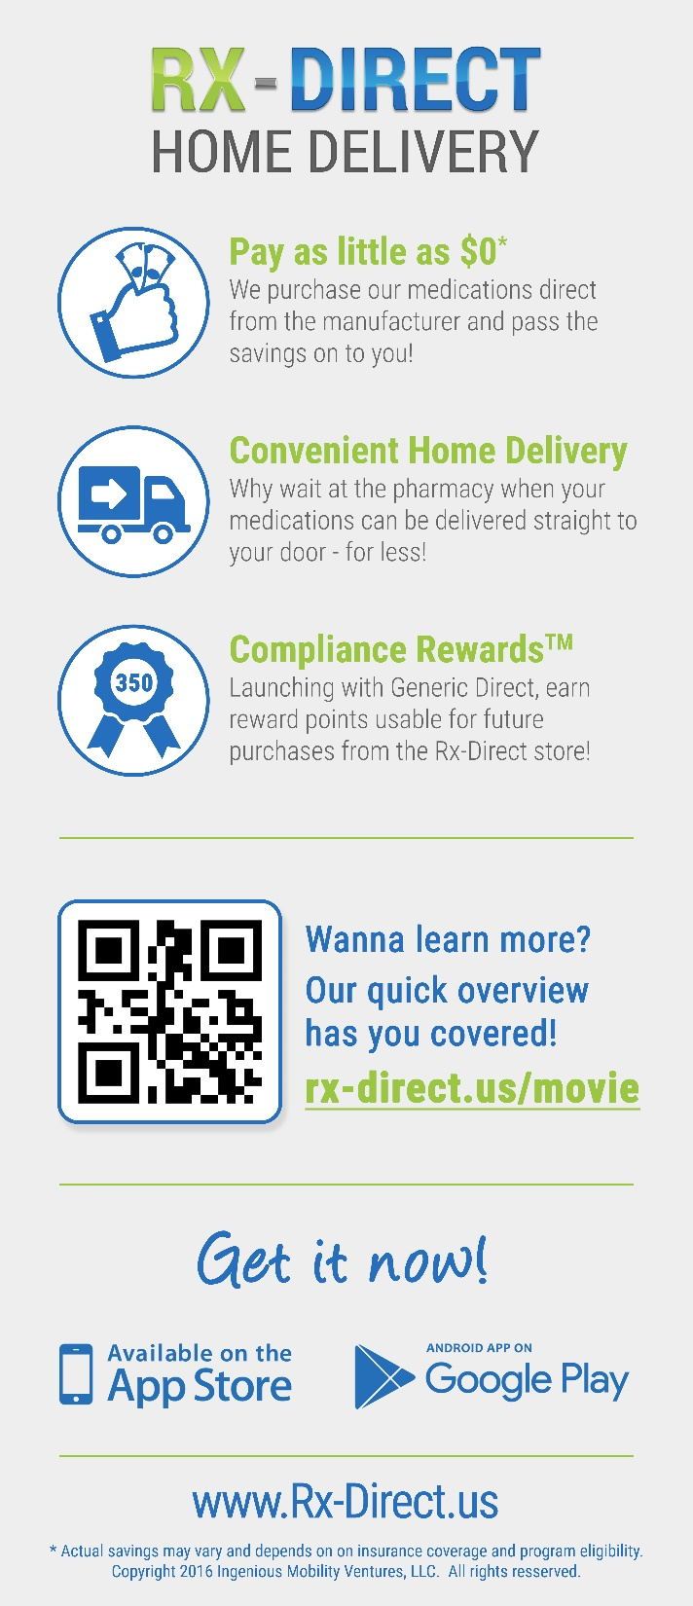
Office LEAVE BEHIND
AB rated, FDA approved generic Oral Solids
No C-II Drugs
Highly Utilized Products
Low cost Acquisition & Handling Fee
Direct-Rx DirectRx.com GENERICRx-Direct GenericRx-direct.com RX-DIRECT www.Rx-Direct.us
© 2016. Prepared for internal use only. This document contains information proprietary and confidential to Ingenious Mobility and is not to be disclosed in whole or in part without the express written consent of IMV.

Slide 12
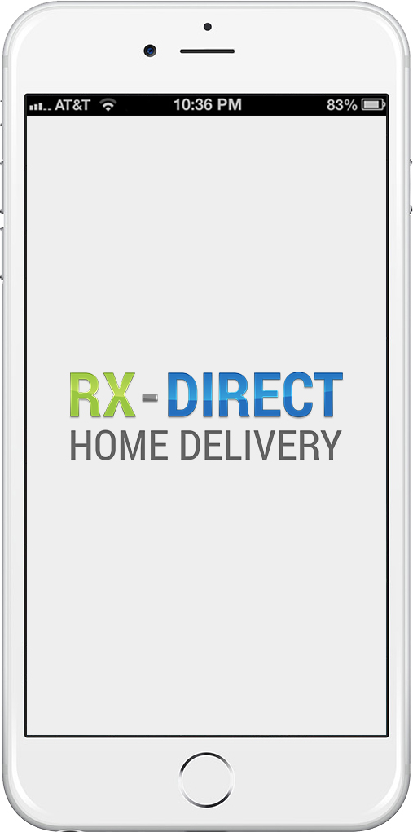


Splash Screen
WELCOME TO THE MOST ENGAGING AND REWARDING HOME DELIVERY PHARMACY IN AMERICA
WELCOME TO THE MOST ENGAGING AND REWARDING HOME DELIVERY PHARMACY IN AMERICA
TAP TO CONTINUE
TAP TO CONTINUE

Slide 13
PROVIDES
Local & National Program Marketing
Compelling offer for Patient, HCP & private network pharmacy
HCP Office Targeting
Sales representatives in HCP offices
iOS /Android /Windows apps
Compliance Rewards™ points program management
Development of $0 Drug List™
Highly Curated formulary program based on current 3rd party reimbursement – allowing Rx’s to be profitable
Direct Sourcing Strategy
Mfr direct purchases --35% less than wholesale
Consistent product every month
Single Point, Expandable Pharmacy Network
Streamline processes & Technology Infrastructure
HIPAA opt in mgmt database & Sponsor Network
Application development
Reporting & Data connectivity
Patient Profile & Queue Mgmt
Payment Collection
Patient In App messaging
Refill reminders
Therapy Milestones
Dormant Patient Detection
Rx expiring notice
New Insurance Card
© 2016. Prepared for internal use only. This document contains information proprietary and confidential to Ingenious Mobility and is not to be disclosed in whole or in part without the express written consent of IMV.

Slide 14

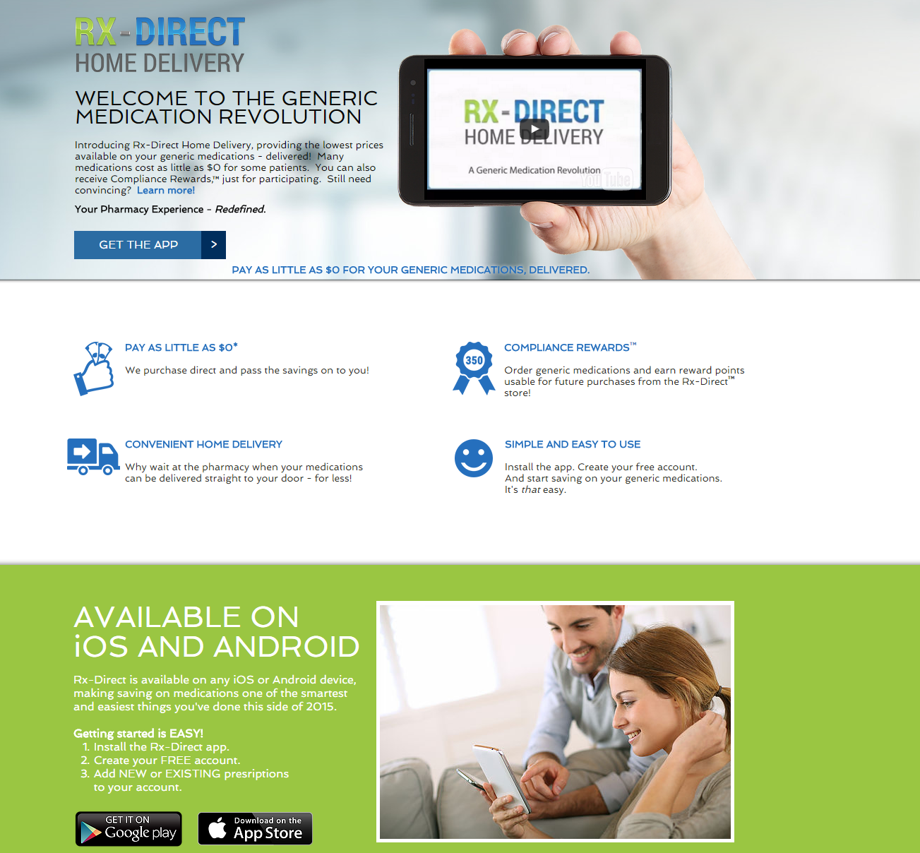

RX-DIRECT Rx-Direct.us
PATIENTS
PROVIDERS
PHARMACIES

Slide 15
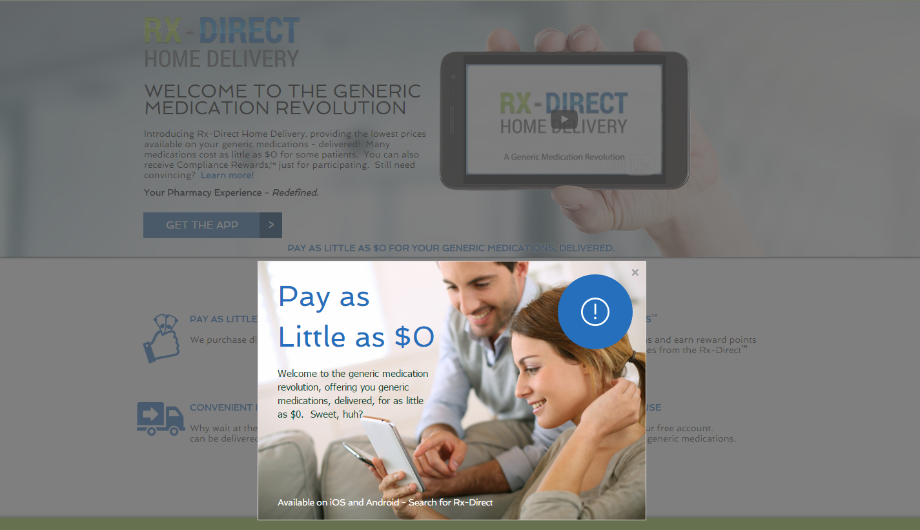
RX-DIRECT Rx-Direct.us
PATIENTS
PROVIDERS
PHARMACIES

Slide 16

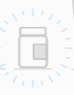


Program Overview
RELAX…
WE’LL KEEP THIS SIMPLE
What We Do
We stock and deliver only tablet and capsule --oral forms-- of popular prescription drugs.
While we don’t to stock every drug- we do carry the most popular generics as pills that do not require special prescriptions.
How We Do It
All our products are US-sourced, FDA-approved, AB rated, highest quality generics.
We buy our medications directly from the drug makers, cutting out the middle man. These savings are then passed on to you.
.
What This Means for You
More time to enjoy life – cross going to the pharmacy off your to-do list
Lower prices- always
Flexible delivery options
Paperless e-services, alerts & reminders
We bill your prescription insurance and your eligible prescriptions will be prepared and sent or even couriered to your location.
Also your medication will look the same every time you refill it– reducing confusion when identifying your pills.
CONTINUE TOUR

Slide 17



Program Marketing
50
WELCOME TO THE WORLD OF
COMPLIANCE REWARDS™
Improve your Health and Earn Points
By participating in our program, you’ll earn valuable reward points that can be applied to purchases from our store!
If you have prescription insurance, you may even earn enough points to lower your cost to $0!
Simple, Straightforward
Earning points is easy:
Record blood pressure, blood glucose etc.
Answer 15 second surveys
Transfer more of your prescriptions
Share the app with a friend!
In no time you’ll be well on your way to receiving $$ off your next purchase.
You can EARN up to 350 points just by registering TODAY.
So let’s get started!
exclusively at
GET STARTED

Slide 18
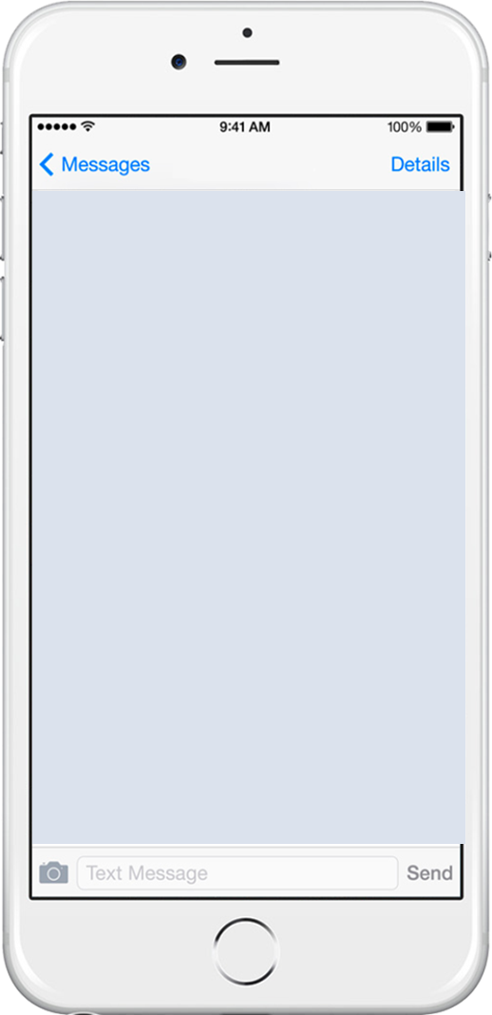

Registration Start
Join
Let’s create your free account
[first_name]
First Name
First Name
Ken
[last_name]
Last Name
Last Name
Burkett
[mobile_number]
Mobile #
Mobile Phone #
817-905-2855
By clicking “Continue” you agree to the
Terms of Use & Privacy Policy
CONTINUE

Slide 19
Verification
Phone Verification
Help us protect your account
A mobile verification code has been sent to your mobile phone via SMS. Key in the code to complete your registration.
Verification Code
Verification Code
568555
Entered a wrong code? Tap Here
Resend Verification Code
CONTINUE

Slide 20
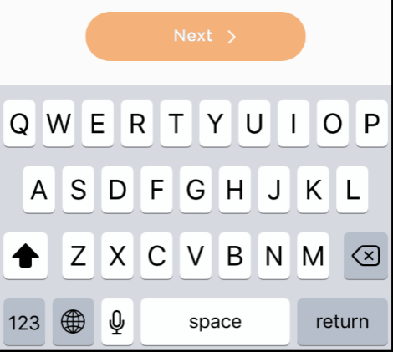
E-mail Entry
E-mail Address
Printing is expensive. We keep our costs low so we can keep your costs low. Plus, it’s cool to be green!
Email Address
E-mail Address
[email]
ken@burkett.mobi
Re-Enter Email address
Confirm E-mail Address
ken@burkett.mobi
Re-try
AGE VERIFICATION

Slide 21
Patient Info
AGE VERIFICATION
We’re almost done!
We just need a few bits of information to complete your medication profile.
MM / DD / YYYY
Male
Date of Birth DD/MM/YYYY
Male
02 / 09 / 1973
Do you have any food or medication allergies?
YES
Why we need this.
YES
NO
Allergies
list your allergies here separate by commas
Peanuts, sulfa, latex, shellfish
DELIVERY INFORMATION

Slide 22
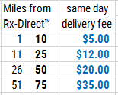
Delivery Address
Delivery Address
Pharmacy waiting lines are so 2015.
Please provide us with the billing address & where you’d like your Rxs delivered.
If the patient selects SAME DAY DELIVERY—
Real query –comparing distance from Rx-Direct™ Network pharmacy to the DELIVERY ADDRESS
Street Address
Suite / Apt
Street address
APT
82 Sycamore Lane SE
7-B
City
Zip Code
City
ZIP
Peachtree City
30339
Location Alias
Location Alias
HOME
WORK
GA Home
THIS ADDRESS IS ALSO MY BILLING ADDRESS
DELIVERY PREFERENCE FOR THIS ADDRESS:
Same day (+ 5.00 only in participating areas)
1-2 days (+ 2.50 National)
You can change your Delivery option at any time.
[address_1]
[apt]
2-3 days (+ 1.50 National)
ADD ANOTHER ADDRESS FOR DELIVERY (up to 4 allowed)
CONTINUE

Slide 23
Entering Address #2
Delivery Address
Added “ GA Home” to your addresses (I of 4)
Please enter your Address #2
Street Address
Suite / Apt
Street address
APT
3201 Fannin
City
Zip Code
City
ZIP
Atlanta
36988
Location Alias
Location Alias
HOME WORK
MidtownPlaza
WORK
THIS ADDRESS IS ALSO MY BILLING ADDRESS
DELIVERY PREFERENCE FOR THIS ADDRESS:
Same day (+ 5.00 only in participating areas)
1-2 days (+ 2.50 National)
You can change your Delivery option at any time.
[address_1]
[apt]
2-3 days (+ 1.50 National)
ADD ANOTHER ADDRESS FOR DELIVERY (up to 4)
CONTINUE

Slide 24
Invalid Street Address
Delivery Address
Address not serviceable by law.
Unfortunately, the state you have provided (GA), is not eligible to enroll in Rx-Direct. For more information, please see our eligibility conditions.
Tap anywhere to close
Pharmacy waiting lines are so 2015.
Please provide us with the address you’d like your Rxs delivered.
Street address
APT
82 Sycamore Lane SE
7-B
City
ZIP
Peachtree City
30339
Address Description
HOME
WORK
GA Home
THIS ADDRESS IS ALSO MY BILLING ADDRESS
ADD ANOTHER ADDRESS FOR DELIVERY
DO YOU HAVE DELIVERY PREFERENCE:
Same day (+ 8.00 only in participating areas)
1-2 days (+ 2.50 National)
You can change your Delivery option at any time.
2-3 days (+ 1.50 National)
CONTINUE
CONTINUE

Slide 25

Billing Information
Payment Information
We’d do this for free if we could.
But until then, we’ll need payment information for your medication costs.
Cardholder Name
Cardholder Name
Ken Burkett
Card Number
Card number
4413 5188 2212 0665
Expires MM / YY
CVV Code
Expires MMYY
CVV
04 / 20
123
RX INSURANCE

Slide 26
Insurance Coverage= Y
Insurance Coverage
You are well on your way! You’ll earn points that you can use towards your purchase
To ensure maximum savings, we need to know about your insurance coverage.
Do you have
prescription drug insurance?
YES
NO
YES

Slide 27
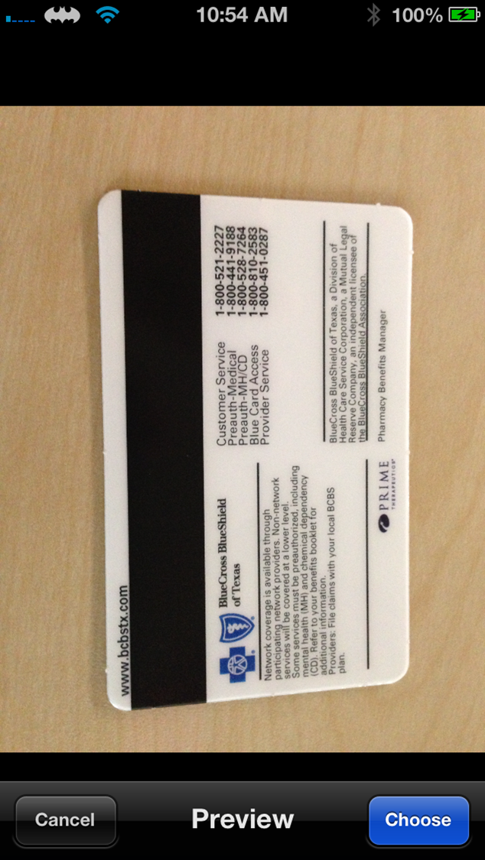


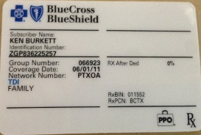
Insurance Card Scan
Insurance Coverage
Typing is overrated.
Please use the buttons below to scan the front and back of your prescription insurance card.
Relationship to cardholder:
SELF
CHILD
SPOUSE
OTHER DEPENDENT
FINISH

Slide 28



Program Overview
Now you're ready to rock!
And let the savings roll in
By completing the registration process, you earned 350 Compliance Reward™ points!
Learn how to spend them.
350
Points Earned!
(+) Add Family Member
Drug Look Up
HOME
POINTS AWARDED SOUND?
TRANSFER A RX TO

Slide 29

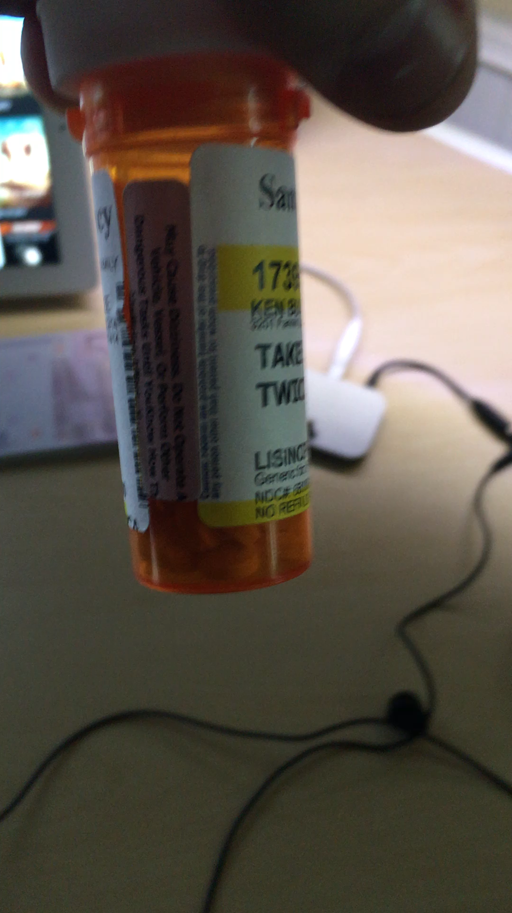

TRANSFER Rx
RX-DIRECT
TRANSFER RX
H O M E D E L I V E R Y
TRANSFERRING YOUR Rx HAS NEVER BEEN EASIER
RX-DIRECT
H O M E D E L I V E R Y
1. Take a short video of medication label from your previous pharmacy
KEN BURKETT
PATIENT
Rx Number
Pharmacy Name
RX-DIRECT
Rx Number
Pharmacy Name
H5689655
Walgreens #4522
Pharmacy Phone
H O M E D E L I V E R Y
2. Once successfully uploaded, the transfer now button will appear
Pharmacy Phone
806-653-6596
Drug Name & Strength
Drug Name
Propranolol 20mg
3. You’ll learn if the medication is immediately refillable or if it is too soon – and would be shipped a few days later
Quantity
Qty Desired
90
OR-
USE OUR EASY VIDEO TRANSFER TOOL
Simply take a 3 second video of your Rx label–
we’ll do the rest!
RECORD
AGAIN
LEARN MORE
AUTHORIZE TRANSFER
© 2016. Prepared for internal use only. This document contains information proprietary and confidential to Ingenious Mobility and is not to be disclosed in whole or in part without the express written consent of IMV.

Slide 30


TRANSFER Rx :2
RX-DIRECT
REQUESTING TRANSFER RX
H O M E D E L I V E R Y
TRANSFERRING YOUR Rx HAS NEVER BEEN EASIER
RELAX…
WE GOT THIS
WE’LL KEEP YOU POSTED OF EVERYTHING
By using us-- billing your Rx insurance, your co-pay will be the same– except we will apply your points to reduce your out of pocket – for this Rx- that's
$3.50 off !
350
Remember, we buy direct only FDA approved, highest quality generics in pill form.
Take that middle man!
View on Pharmacy Queue
CONFIRM PAYMENT
© 2016. Prepared for internal use only. This document contains information proprietary and confidential to Ingenious Mobility and is not to be disclosed in whole or in part without the express written consent of IMV.

Slide 31
CONFIRM Billing Information
Payment Card Number
CONFIRM PAYMENT
Just we’ll need payment information for your medication and handling fees.
Cardholder Name
Ken Burkett
Payment Card Number
Expires
**** 0665
04/20
ADD ANOTHER PAYMENT CARD
CVV
USE THIS PAYMENT CARD
123
DELIVERY ADDRESS (2 on file)
Address Alias
s
1) GA Home
ADD ANOTHER ADDRESS FOR DELIVERY
USE THIS ADDRESS
DELIVERY PREFERENCE FOR THIS RX:
Same day (+ 5.00 only in participating areas)
1-2 days (+ 2.50 National) PROFILE DEFAULT
2-3 days (+ 1.50 National)
TRANSFER NOW

Slide 32
TRANSFER Rx :3
RX-DIRECT
TRANSFERRING RX
H O M E D E L I V E R Y
TRANSFERRING YOUR Rx HAS NEVER BEEN EASIER
WE DO THIS EVERY DAY
Once your Rx is successfully transferred, you will receive in-app notifications confirming:
1. Successful Transfer
2. Out of Pocket Cost (Before & After Point Benefits)
3. Order / Shipment Tracking Information
350
All of our interactions with you are found in your notifications and inside the app
TRANSACTION SUMMARY
View on Pharmacy Queue
© 2016. Prepared for internal use only. This document contains information proprietary and confidential to Ingenious Mobility and is not to be disclosed in whole or in part without the express written consent of IMV.

Slide 33

TRANSACTION
RX-DIRECT
Tracking Details
H O M E D E L I V E R Y
YOUR PROPRANOLOL 20mg ORDER
#8461234 – IN TRANSIT
Latest update: Tuesday, Feb 8th 2016
10:21 AM | SCHEDULED Package arrival Rome, GA
Monday, Feb 7th 2016
6:47 PM | Order left RxDirect Dallas, Texas US POST FIRST CLASS Carrier Tracking #: 1Z3920482039104
3:13 PM | BILLED VISA ** 1028 $ 3.75
3:11 PM | INS COPAY: $ 5.00 2 day HANDLING FEE: $ 2.25 STATE TAX $ 0.00 COMPLIANCE REWARDS - $ 3.50
2:45 PM | Rx TRANSFER COMPLETE COMPLIANCE REWARDS EARNED: 350 Assigned Rx: 845635 TX
10:11 AM | Rx TRANSFER REQUEST MADE
10:11 AM | Rx TRANSFER REQUEST
RETURN TO MY ORDERS
© 2016. Prepared for internal use only. This document contains information proprietary and confidential to Ingenious Mobility and is not to be disclosed in whole or in part without the express written consent of IMV.

Slide 34
Non-Participating Drug
Failed Transfer Request
Rx Transfer Failure
YOUR Rx TRANSFER WAS NOT SUCCESSFUL!
The medication your requested to transfer is not one of the generic medications we supply.
In order for Rx-Direct to provide the lowest prices on the market, we only provide generic medications in pill, tablet, and capsule form. The prescription you attempted to transfer is not one of our provided medications. We apologize for this inconvenience, and as an act of good will, have provided you with 100 incentive reward points, usable in the Rx-Direct Store.
DRUG LOOKUP
Search our database of available medications
100
RETURN TO RX TRANSFER

Slide 35
Rx Not Yet Fillable
Rx Transfer Failure
YOUR Rx IS NOT YET REFILLABLE
We have received your prescription transfer,
but it is not yet due for a refill.
We have successfully transferred your prescription to Rx-Direct, but it is not yet due for a refill. We will notify you under MyAlerts when a refill order is available. If you’d like to have this medication shipped to you as soon as a refill is available, simply click the Pre-Authorize Refill link below.
PRE-AUTHORIZE REFILL
Authorization received. We will notify you once your order has been shipped on the My Alerts page.
GO TO MAIN MENU

Slide 36
Insurance Coverage= N
Insurance Coverage
You are well on your way! You’ll earn points that you can use towards your purchase
To ensure maximum savings, we need to know about your insurance coverage.
Do you have
prescription drug insurance?
NO
YES
NO
FINISH

Slide 37








Home Screen
No Insurance on file scenario
My Profile
My Rx Orders
My Alerts
Drug Lookup
Compliance Rewards™
KEN BURKETT
3 ACTIVE
(3) NEW (7) OLD
(2) SEARCHES
350
Med Hotline
My Points
Share with Friends

Slide 38

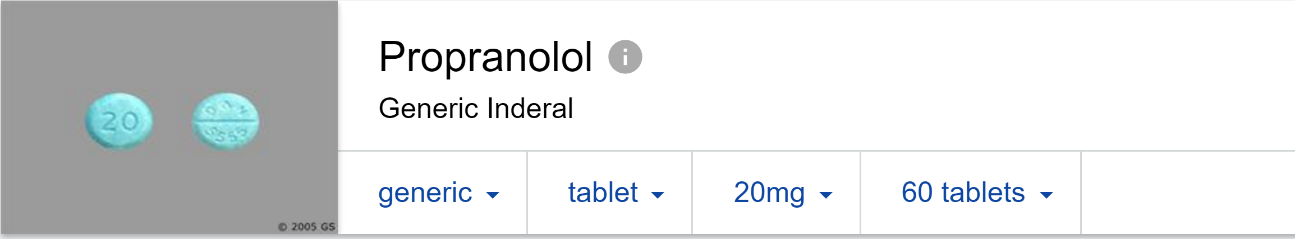

No insurance on file scenario
CHECK CASH PRICE
COMPLIANCE REWARDS™
RX-DIRECT
DRUG LOOK UP
H O M E D E L I V E R Y
H O M E D E L I V E R Y
Propranolol
RX-DIRECT
10mg
20mg t
40mg
SELECT QUANITY
H O M E D E L I V E R Y
1
10
20
28
30
40
60
90
100
120
60 pills
PROPRANOLOL 20MG
$ 9.44
REDEEMED COMPLIANCE REWARDS™ BALANCE
YOUR RX PRICE
$ 6.29
Enter a custom qty
Qty
SET
RETAIL PHARMACY PRICE ESTIMATES
$14.19 to $26.96
BEGIN RX TRANSFER TO
SAVE SEARCH
© 2016. Prepared for internal use only. This document contains information proprietary and confidential to Ingenious Mobility and is not to be disclosed in whole or in part without the express written consent of IMV.

Slide 39
No Rx insurance on file scenario
INSURANCE or CASH
COMPLIANCE REWARDS™
RX-DIRECT
INSURANCE / CASH PAY
H O M E D E L I V E R Y
H O M E D E L I V E R Y
RX-DIRECT
H O M E D E L I V E R Y
60 pills
PROPRANOLOL 20MG
$ 9.44
REDEEMED COMPLIANCE REWARDS™ BALANCE
YOUR RX PRICE
$ 6.29
NO PRESCRIPTION DRUG INSURANCE ON FILE--
WOULD YOU LIKE TO UPLOAD YOUR RX INSURANCE CARD NOW?
CASH PAY
RX INSURANCE
NO
YES
UPDATE
© 2016. Prepared for internal use only. This document contains information proprietary and confidential to Ingenious Mobility and is not to be disclosed in whole or in part without the express written consent of IMV.

Slide 40
ADD RX INSURANCE TO MY PROFILE
RX INSURANCE
RX-DIRECT
EDIT MY PROFILE
H O M E D E L I V E R Y
EDIT MY PROFILE
BURKETT DOB: 11-16-1965 (M)
KEN
email
ken@burkett.mobi
Mobile number
Back Up Phone Number
303-757-6965
303-757-6965
ALLERGIES
EDIT [ + ]
DELIVERY ADDRESS (2)
EDIT [ + ]
DEPENDENTS (1)
EDIT [ + ]
BILLING ADDRESS
EDIT [ + ]
RX INSURANCE CARD (1)
EDIT [ + ]
PAYMENT INFORMATION
EDIT [ + ]
RELATIONSHIP
Cardholder
Spouse
Child
Other Dependent
UPDATE
Copyright © 2016 Ingenious Mobility Ventures
© 2016. Prepared for internal use only. This document contains information proprietary and confidential to Ingenious Mobility and is not to be disclosed in whole or in part without the express written consent of IMV.

Slide 41
TRANSFER
FROM PRICE HISTORY
RX-DIRECT
SAVED DRUG SEARCHS
H O M E D E L I V E R Y
2 SAVED SEARCHES
+
ADD ANOTHER SEARCH
RECENT SEARCHES CLEAR ALL
2-15-2016
PROPRANOLOL TAB
Strength: 20mg
Qty # 60
Cash Pay Home Delivery Price $9.44
2-10-2016
Warfarin (COUMADIN generic)
Strength: 2mg
Qty # 60
Cash Pay Home Delivery Price $16.35
IS PROPRANOLOL 20mg A CURRENT RX YOU HAVE WITH A LABEL FROM ANOTHER PHARMACY?
CLEAR
REPRICE
START Rx TRANSFER
NO
YES
CLEAR
REPRICE
START Rx TRANSFER
HOME
© 2016. Prepared for internal use only. This document contains information proprietary and confidential to Ingenious Mobility and is not to be disclosed in whole or in part without the express written consent of IMV.

Slide 42
CURRENT RX?
RX-DIRECT
REQUEST A RX
H O M E D E L I V E R Y
Prescriptions may be obtained by Rx-Direct one of 3 ways
1
Your doctor may call in a prescription for you : 817-274-8200
2
Your doctor’s office may fax your prescription: 817-274-8205
3
Your doctor’s office may ePrescribe your prescription: RX-DIRECT HOME DELIVERY ARLINGTON, TX
HOME
© 2016. Prepared for internal use only. This document contains information proprietary and confidential to Ingenious Mobility and is not to be disclosed in whole or in part without the express written consent of IMV.

Slide 43
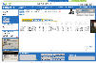
Main Menu
STATIC
My Profile
My Rx Orders
My Alerts
Drug Lookup
Compliance Rewards™
KEN BURKETT
3 ACTIVE
SCROLLING
REGION
(3) NEW (7) OLD
(2) SEARCHES
TRANSFER A RX TO
STATIC
350
Med Hotline
My Points
Share with Friends

Slide 44
Slide Menu
RX-DIRECT
H O M E D E L I V E R Y
MAIN MENU
MY PROFILE
MY MEDS
MY REWARDS
SETTINGS
MAIN MENU
  Goes to the application’s main menu screen
MY PROFILE
  Goes to the shipping, payment, insurance, allergy, demographics, etc.
MY MEDS
  Shows all medications user has ordered and provides ability to add new Rx. This is where participants can refill, see cost and shipping info, etc.
MY REWARDS
  Shows point balance info, ways to earn, possible rewards/savings, etc.
SETTINGS
  Application settings (notification options), option to remove or change user account, etc.
Registration Complete!
Ready to save?
Add you’re your prescription medications to My Drugs.
Add Your Prescriptions
Main Menu
Quick Stats
Savings to Date: $282.44
Rx’s Shipped: 7
Open Orders: 2
Reward Points Earned!
By completing the registration process, you earned 37 compliance reward points. Learn more.
Lifetime Rewards: 1075
Current Rewards: 350
37
Terms of Service
Version 1.0 (20151201)
© 2016 Ingenious Mobility Ventures, LLC
© 2016. Prepared for internal use only. This document contains information proprietary and confidential to Ingenious Mobility and is not to be disclosed in whole or in part without the express written consent of IMV.

Slide 45
BENEFITS TO PATIENT
Rx’s cost less with Compliance Rewards™
Consistency same shape, size & color
Safety & Compliance messaging Refill reminders, alerts, status, & recall
Tips & Nurse resources
No paper
Convenient, Local delivery options
Easy Transfer of their Rx

Slide 46
WHY THIS KIND OF OFFER-- NOW?
Patients accustomed to smartphones / SMS services
Sponsor has Direct connection to Patient
Curated, Evolving Formulary
New Customer acquisition <$5
Efficient pharmacy network; filled anywhere
© 2016. Prepared for internal use only. This document contains information proprietary and confidential to Ingenious Mobility and is not to be disclosed in whole or in part without the express written consent of IMV.

Slide 47
BENEFITS TO HCP
Compliance Rewards™ satisfies Patient engagement requirement for CMS’ Shared Savings Program.¹
Better disease control- reduced “clawbacks” from Patient non-compliance
Compliance Rewards™ -- means all Rx’s cost patient less
Pt’s Rx same shape, size & color every month
Pt Safety advisories; notices prior to renewal, dormant, recalls, or shortages
Rx Tips & Nurse resources included
Better informed, more engaged patient
Option to receive app to see their patient’s compliance
¹ Section 3022 of the Patient Protection and Affordable Care Act of 2010 Accountable Care Organizations (42 U.S.C. §§ 1395, et seq.). See also 76 Fed. Reg. 67976

Slide 48
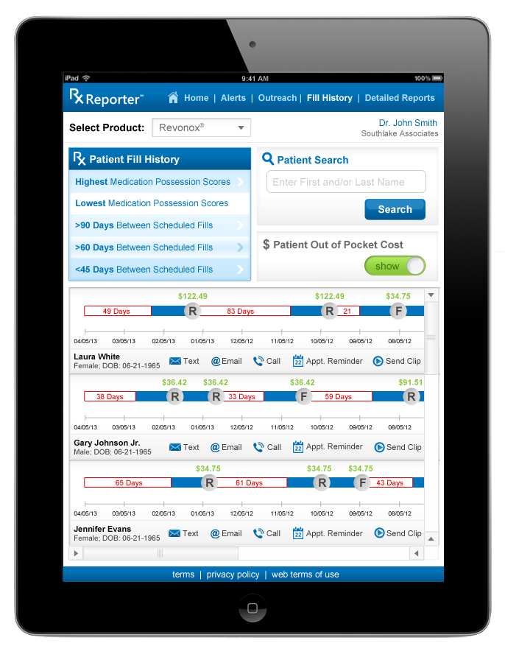
Optional
HCP COMPLIANCE DASHBOARD
    Gives HCP the option to follow their least compliant through our network
© 2016. Prepared for internal use only. This document contains information proprietary and confidential to Ingenious Mobility and is not to be disclosed in whole or in part without the express written consent of IMV.

Slide 49
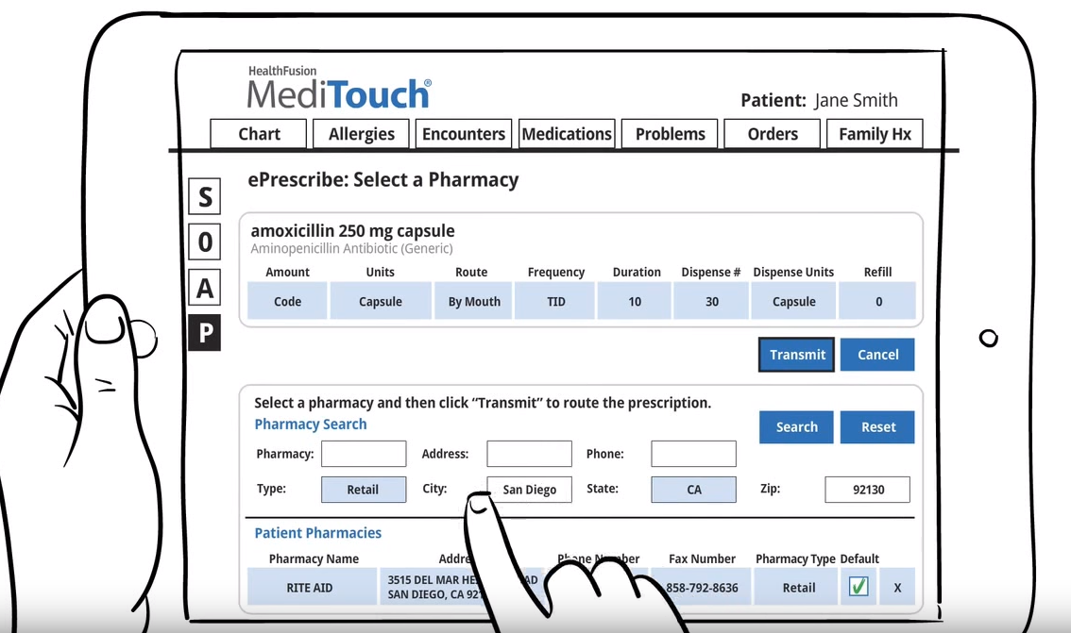
HCP E-PRESCRIBE
ATORVASTATIN CALCIUM ( compare to brand LIPITOR®)
HMG CoA Reductase Inhibitor
Code Tablet By Mouth QAM 30 30 Tablet 11
CANCEL
OK
OK
TRANSMIT
TRANSMIT
Rx-Direct
Arlington
TX
© 2016. Prepared for internal use only. This document contains information proprietary and confidential to Ingenious Mobility and is not to be disclosed in whole or in part without the express written consent of IMV.

Slide 50




SINGLE POINT PRESCRIBE™
California Patient
Florida Patient
Routes Rx’s to
Distributes orders to participating network pharmacies
$0.18
Ability to Process Volume– Load Balance
Proximity to Patient - faster shipping
Greater capacity
Locations having earned higher pt satisfaction ratings
Rx-Direct private network e
Pharmacy HQ
ARIZONA
Rx-Direct private network e
Script N’ Save
FLORIDA
$0.08
TEXAS
© 2016. Prepared for internal use only. This document contains information proprietary and confidential to Ingenious Mobility and is not to be disclosed in whole or in part without the express written consent of IMV.

Slide 51

[SPLASH PAGE]
PHARMACY
Pharmacy Log In
New Pharmacy User ?
Email
Forgot email?
Register Now >>
Password or SitePass
Forgot password?
Login >>
Questions about the Rx-Direct Web Access : Internet help desk: 888-xxx-xxxx 5am – 8pm EST 7 days a week
3201 FANNIN LN l Suite 200 l SOUTHLAKE, TX 76092 (888) 495-7271 info@Rx-Direct.us © 2016 All rights reserved Privacy Policy

Slide 52
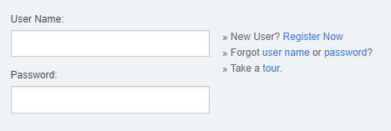
[SPLASH PAGE]
PHARMACY
Register Pharmacy
Pharmacy NPI (as it appears on your license)
Pharmacy Type
145569858
Retail
Compounding Specialty
Public Institutional
Hospital
Site Pass Number
4JT256
Next >>
Select
SCRIPT N SAVE PHARMACY # 205
16986 S. BELLEFLOWER PL CONSHOHOCKEN PA 27080
Not Me
Next >>
3201 FANNIN LN l Suite 200 l SOUTHLAKE, TX 76092 (888) 495-7271 info@Rx-Direct.us © 2016 All rights reserved Privacy Policy

Slide 53
[SPLASH PAGE]
SCRIPT N SAVE PHARMACY # 205
16986 S. BELLEFLOWER PL CONSHOHOCKEN PA
Change
Pharmacy Phone: 888-568-9600
Once prescriptions arrive to your work queue in the Rx-Direct Portal. You Will be notified if a prescription filling opportunity is idle for longer than 20 minutes during work hours.
Passwords will be automatically generated & sent to Contacts #2 and #3
Secondary Contacts
Pharmacist in Charge at Facility
Pharmacy Contact #2 Name
Pharmacy Portal
Product Catalog
Drug Information
Pharmacy Locator
Customer Service
Forms
Steven
Vanser
Tamara
Johnson-Watson
First Name
Last Name
First Name
Last Name
Notification Phone #
Pharmacy Contact #2 Email
Notification Phone #
Email address
svanser@scriptnsave.com
281-685-3658
tjohnson@scriptnsave.com
469-596-4588
Mobile
Mobile
Choose Password
Retype Password
Pharmacy Contact #3 Name
(4-10 characters; Alpha Numeric)
Morton
Najeep
******
******
First Name
Last Name
Facility Operation Phone Hours
Pharmacy Contact #3 Email
Notification Phone #
Monday
: AM
: PM
8 30 6 00
mnajeep@scriptnsave.com
605-949-6825
Mobile
Tuesday
: AM
: PM
8 30 6 00
Wednesday
: AM
: PM
8 30 6 00
I accept the Terms of Use
Thursday
: AM
: PM
8 30 6 00
Friday
I authorize real time advisories as prescription claims for the this pharmacy location linked to either my email or mobile number Privacy Policy
: AM
: PM
8 30 6 00
Saturday
: AM
: PM
9 00 2 00
Sunday
Next >>
: AM
: PM
3201 FANNIN LN l Suite 200 l SOUTHLAKE, TX 76092 (888) 495-7271 info@Rx-Direct.us © 2016 All rights reserved Privacy Policy

Slide 54
[SPLASH PAGE]
PHARMACY
Pharmacy Log In
New Pharmacy User ?
Email
SVANSER@SCRIPTNSAVE.COM
Register Now >>
Forgot email?
Password or SitePass
*********
Forgot password?
Login >>
Questions about the Rx-Direct Web Access : Internet help desk: 888-xxx-xxxx 5am – 8pm EST 7 days a week
3201 FANNIN LN l Suite 200 l SOUTHLAKE, TX 76092 (888) 495-7271 info@Rx-Direct.us © 2016 All rights reserved Privacy Policy

Slide 55


PHARMACY QUEUE
11:41:18 CST
TUESDAY JANUARY 29 2016
You are currently logged in as:
Steven Vanser, R.Ph. (LOGOUT)
THE AVERAGE NUMBER OF PRESCRIPTIONS PROCESSED EACH DAY
42%
0h 41m
THE AVERAGE TIME IT TAKES YOUR PHARMACY TO PROCESS AN RX
37
THE % OF NEW PRESRIPTIONS
PROCESSED BY YOU THIS WEEK
Stats current as of 03/17/2016
@ 11:37:01 AM
PHARMACY PROFILE
2817 Filler Lane, #201
Hadwick, VT 05843
(802) 555-5555 - PH
(802) 555-2222 - FX
NEW & TRANSFER REQUESTS (108)
PENDING REFILL RX’s (6)
PROCESSED RX’s (238)
RECEIVED PATIENT NAME DOB HAS RX INS CARD ? RX SEARCHED QTY CASH PRICE QUOTED STATUS
EDIT
?
USER PROFILES
01/29/2016 @ 03:17 PM
01/29/2016 @ 03:11 PM
01/29/2016 @ 02:42 PM
01/29/2016 @ 01:33 PM
01/29/2016 @ 11:37 AM
01/29/2016 @ 11:03 AM
01/29/2016 @ 09:52 AM
01/29/2016 @ 08:01 AM
01/28/2016 @ 04:58 PM
SAMPLE, NICOLAS 07/13/1981 N
BLACK, KAREN D. 08/22/1977 Y
FULLERTON, DAVID L. 01/02/1991 Y
GRAVES, NATALIE O. 12/30/1947 Y
JACKSON, FRANK P. 11/08/1959 Y
BURKETT, KENNETH A. 02/02/1970 N
KELLER, EMMA J. 05/15/1988 Y
JONES, BARBARA K. 01/27/1952 Y
HARBIN, RORY T. 04/01/1939 Y
PROPRANOLOL 20MG 90 $ 9.44 OPEN BY OTHER USER (locked)
CITALOPRAM 20MG 90 $ 29.44 OPEN BY OTHER USER (locked)
IBUPROFEN 800MG 180 $ 19.44 PENDING
OMEPRAZOLE 40MG 30 $ 9.44 PENDING
ATENOLOL 50MG 100 $ 16.44 PENDING
RANITIDINE 300MG 60 $ 9.44 PENDING
LISINOPRIL 5MG 30 $ 8.44 PENDING
METFORMIN 500MG 100 $ 31.44 PENDING
COMPOUND RX -- ------- PENDING
Pharmacists 2
Staff 5
Other 1
NEW PT
SELECT
EDIT
SELECT
Queue Overview
SELECT
New / Open 9
Pending 6
Processed 238
SELECT
NEW PT
SELECT
REPORTS
SELECT
RX QUEUE
STATUSES
OPEN BY OTHER USER
Prescription is currently open by another user and cannot be viewed.
Pending
Prescription has not been viewed by any user.
REPORTS
PATIENT LOOKUP
PAGE << 1 of 1 >>
© 2016. Prepared for internal use only. This document contains information proprietary and confidential to Ingenious Mobility and is not to be disclosed in whole or in part without the express written consent of IMV.

Slide 56




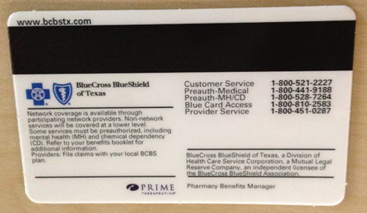
TRANSFER RX SELECTED
11:41:18 CST
NICHOLAS K.
SAMPLE
29
MEMBER SINCE
2
4
TUESDAY JANUARY 29 2016
11/16/ 1977
year old
MALE
01 2016
DEPENDENTS
PROGRAM Rx’s
<edit>
ALLERGIES
REQUEST REC’D MEDICATION DISP PHARMACY PHARMACY RX QUOTED PT VIDEO
PENICILLIN
NEW PT
PEANUTS
DATE NAME QTY NAME PHONE NUMBER CASH ATTACHMENT
MANGO
1/29/2016 @ 3:17 PM PROPRANOLOL 20mg 90 SAMS PHARMACY 806-653-6502 H5689655 $ 9.44
SELECT
Mobile number
SELECT
1/29/2016 @ 3:25 PM OXYCODONE 40mg 30 SAMS PHARMACY 806-653-6502 H5689648 $ 96.98
303-757-6965
SELECT
1/29/2016 @ 3:45 PM REVLIMID 40mg 60 WALMARTPHARMACY 806-653-6502 H5689677 $ 1096.73
Back Up Phone Number
SELECT
1/29/2016 @ 3:45 PM LISINOPRIL 10mg 30 COSTCO PHARMACY 806-653-6502 H5689677 $ 6.90
303-757-6965
<edit>
Shows all current requests in queue for the patient
ADDRESS 1 : “NICK HOME”
16320 E Hardwick Place
APT 7-B
SOUTHLAKE TX 76092
ADDRESS 2 : “NICK WORK”
<edit>
13 Olympic Ave
STE 130
Fort Worth TX 75851
PAGE << 1 of 1 >>
SEND PATIENT MESSAGE (email)
MEDICATION SPECIFIC MESSAGE -- SEND PATIENT MESSAGE (in app)
|
NOT CARRIED/Out of STOCK
CALLING MD
INS DECLINED
ADMIN STATUS
CARDHOLDER
C-II Drug- Cannot Fill
No Refills; Calling HCP
Refill too Soon- $ Option
PROCESSING
Rx Not Carried for Now
Rx Expired; Calling HCP
Ins Declined- $ Option
PENDING PHMCY REPLY
MD Declined – Can't fill
Step Edit / PA- $ Option
DELAYED / Rx ON ORDER
Ins not Accepted-- $
COURIER DELIVERY
CANCEL
SEND
SHIPPED
© 2016. Prepared for internal use only. This document contains information proprietary and confidential to Ingenious Mobility and is not to be disclosed in whole or in part without the express written consent of IMV.

Slide 57
PROCESSED BUTTON SELECTED
11:41:18 CST
NICHOLAS K.
SAMPLE
29
MEMBER SINCE
2
4
TUESDAY JANUARY 29 2016
11/16/ 1977
year old
MALE
01 2016
DEPENDENTS
PROGRAM Rx’s
<edit>
ALLERGIES
REQUEST REC’D MEDICATION DISP PHARMACY PHARMACY RX QUOTED PT VIDEO
PENICILLIN
NEW PT
PEANUTS
DATE NAME QTY NAME PHONE NUMBER CASH ATTACHMENT
MANGO
SELECT
1/29/2016 @ 3:25 PM OXYCODONE 40mg 60 SAMS PHARMACY 806-653-6502 H5689648 $ 96.98
1/29/2016 @ 3:17 PM PROPRANOLOL 20mg 30 SAMS PHARMACY 806-653-6502 H5689655 $ 9.44
Mobile number
1/29/2016 @ 3:45 PM REVLIMID 40mg 60 WALMARTPHARMACY 806-653-6502 H5689677 $ 1096.73
303-757-6965
1/29/2016 @ 3:45 PM LISINOPRIL 10mg 30 COSTCO PHARMACY 806-653-6502 H5689677 $ 6.90
Back Up Phone Number
303-757-6965
ADDRESS 1 : “NICK HOME”
<edit>
16320 E Hardwick Place
PROCESSED Rx
APT 7-B
SOUTHLAKE TX 76092
PROPRANOLOL 20mg
<edit>
30
ADDRESS 2 : “NICK WORK”
<edit>
Qty _________
$0.49
13 Olympic Ave
Rx Ing Cost ______________________________
$16.88
STE 130
Ins Reimbursed __________________________
Fort Worth TX 75851
$7.50
Insurance CoPay_________________________
Cash Pay Amount________________________
CANCEL
SEND
PAGE << 1 of 1 >>
SEND PATIENT MESSAGE (email)
MEDICATION SPECIFIC MESSAGE -- SEND PATIENT MESSAGE (in app)
|
NOT CARRIED/Out of STOCK
CALLING MD
INS DECLINED
ADMIN STATUS
CARDHOLDER
C-II Drug- Cannot Fill
No Refills; Calling HCP
Refill too Soon- $ Option
PROCESSING
Rx Not Carried for Now
Rx Expired; Calling HCP
Ins Declined- $ Option
PENDING PHMCY REPLY
MD Declined – Can't fill
Step Edit / PA- $ Option
DELAYED / Rx ON ORDER
Ins not Accepted-- $
COURIER DELIVERY
CANCEL
SEND
SHIPPED
© 2016. Prepared for internal use only. This document contains information proprietary and confidential to Ingenious Mobility and is not to be disclosed in whole or in part without the express written consent of IMV.

Slide 58
C-II BUTTON SELECTED
11:41:18 CST
NICHOLAS K.
SAMPLE
29
MEMBER SINCE
2
4
TUESDAY JANUARY 29 2016
11/16/ 1977
year old
MALE
01 2016
DEPENDENTS
PROGRAM Rx’s
<edit>
ALLERGIES
REQUEST REC’D MEDICATION DISP PHARMACY PHARMACY RX QUOTED PT VIDEO
PENICILLIN
NEW PT
PEANUTS
DATE NAME QTY NAME PHONE NUMBER CASH ATTACHMENT
MANGO
SELECT
1/29/2016 @ 3:25 PM OXYCODONE 40mg 60 SAMS PHARMACY 806-653-6502 H5689648 $ 96.98
Mobile number
1/29/2016 @ 3:45 PM REVLIMID 40mg 60 WALMARTPHARMACY 806-653-6502 H5689677 $ 1096.73
303-757-6965
1/29/2016 @ 3:45 PM LISINOPRIL 10mg 30 COSTCO PHARMACY 806-653-6502 H5689677 $ 6.90
Back Up Phone Number
303-757-6965
<edit>
ADDRESS 1 : “NICK HOME”
16320 E Hardwick Place
C-II DRUG: CANNOT FILL
APT 7-B
SOUTHLAKE TX 76092
OXYCODONE 40mg
Medication ________________________________
ADDRESS 2 : “NICK WORK”
<edit>
60
13 Olympic Ave
Qty _________
STE 130
Fort Worth TX 75851
CANCEL
SEND
PAGE << 1 of 1 >>
SEND PATIENT MESSAGE (email)
MEDICATION SPECIFIC MESSAGE -- SEND PATIENT MESSAGE (in app)
|
NOT CARRIED/Out of STOCK
CALLING MD
INS DECLINED
ADMIN STATUS
C-II Drug- Cannot Fill
No Refills; Calling HCP
Refill too Soon- $ Option
PROCESSING
CARDHOLDER
Rx Not Carried for Now
Rx Expired; Calling HCP
Ins Declined- $ Option
PENDING PHMCY REPLY
MD Declined – Can't fill
Step Edit / PA- $ Option
DELAYED / Rx ON ORDER
Ins not Accepted-- $
COURIER DELIVERY
CANCEL
SHIPPED
SEND
© 2016. Prepared for internal use only. This document contains information proprietary and confidential to Ingenious Mobility and is not to be disclosed in whole or in part without the express written consent of IMV.

Slide 59
NOT CARRIED BUTTON SELECTED
11:41:18 CST
NICHOLAS K.
SAMPLE
29
MEMBER SINCE
2
4
TUESDAY JANUARY 29 2016
11/16/ 1977
year old
MALE
01 2016
DEPENDENTS
PROGRAM Rx’s
<edit>
ALLERGIES
SILVER
PENICILLIN
REQUEST REC’D MEDICATION DISP PHARMACY PHARMACY RX QUOTED PT VIDEO
PEANUTS
NEW PT
DATE NAME QTY NAME PHONE NUMBER CASH ATTACHMENT
MANGO
1/29/2016 @ 3:45 PM REVLIMID 40mg 60 WALMARTPHARMACY 806-653-6502 H5689677 $ 1096.73
SELECT
Mobile number
1/29/2016 @ 3:45 PM LISINOPRIL 10mg 30 COSTCO PHARMACY 806-653-6502 H5689677 $ 6.90
303-757-6965
Back Up Phone Number
303-757-6965
<edit>
ADDRESS 1 : “NICK HOME”
16320 E Hardwick Place
MEDICATION NOT STOCKED: CANNOT FILL
APT 7-B
SOUTHLAKE TX 76092
REVLIMID 40mg
Medication ________________________________
ADDRESS 2 : “NICK WORK”
<edit>
60
13 Olympic Ave
Qty _________
STE 130
Pharmacy Comments ______________________
___________________________________________
Fort Worth TX 75851
CANCEL
SEND
PAGE << 1 of 1 >>
SEND PATIENT MESSAGE (email)
MEDICATION SPECIFIC MESSAGE -- SEND PATIENT MESSAGE (in app)
|
NOT CARRIED/Out of STOCK
CALLING MD
INS DECLINED
ADMIN STATUS
CARDHOLDER
C-II Drug- Cannot Fill
No Refills; Calling HCP
Refill too Soon- $ Option
PROCESSING
Rx Not Carried for Now
Rx Expired; Calling HCP
Ins Declined- $ Option
PENDING PHMCY REPLY
MD Declined – Can't fill
Step Edit / PA- $ Option
DELAYED / Rx ON ORDER
Ins not Accepted-- $
COURIER DELIVERY
CANCEL
SEND
SHIPPED
© 2016. Prepared for internal use only. This document contains information proprietary and confidential to Ingenious Mobility and is not to be disclosed in whole or in part without the express written consent of IMV.

Slide 60
INS CLAIM DENIED BUTTON SELECTED
11:41:18 CST
NICHOLAS K.
SAMPLE
29
MEMBER SINCE
2
4
TUESDAY JANUARY 29 2016
11/16/ 1977
year old
MALE
01 2016
DEPENDENTS
PROGRAM Rx’s
<edit>
ALLERGIES
REQUEST REC’D MEDICATION DISP PHARMACY PHARMACY RX QUOTED PT VIDEO
PENICILLIN
NEW PT
PEANUTS
DATE NAME QTY NAME PHONE NUMBER CASH ATTACHMENT
MANGO
SELECT
1/29/2016 @ 3:45 PM LISINOPRIL 10mg 30 COSTCO PHARMACY 806-653-6502 H5689677 $ 6.90
Mobile number
303-757-6965
Back Up Phone Number
303-757-6965
<edit>
ADDRESS 1 : “NICK HOME”
16320 E Hardwick Place
Ins DECLINED: REFILL TO SOON
APT 7-B
SOUTHLAKE TX 76092
LISINOPRIL 10mg
Medication ________________________________
ADDRESS 2 : “NICK WORK”
<edit>
30
02-02-16
Qty _________
Next Refillable _______________
13 Olympic Ave
1-800-521-2227
STE 130
MBR CUST SVC # _______________________
Fort Worth TX 75851
BCBS GA
INSURER ______________
CANCEL
SEND
PAGE << 1 of 1 >>
SEND PATIENT MESSAGE (email)
MEDICATION SPECIFIC MESSAGE -- SEND PATIENT MESSAGE (in app)
|
NOT CARRIED/Out of STOCK
CALLING MD
INS DECLINED
ADMIN STATUS
CARDHOLDER
C-II Drug- Cannot Fill
No Refills; Calling HCP
Refill too Soon- $ Option
PROCESSING
Rx Not Carried for Now
Rx Expired; Calling HCP
Ins Declined- $ Option
PENDING PHMCY REPLY
MD Declined – Can't fill
Step Edit / PA- $ Option
DELAYED / Rx ON ORDER
Ins not Accepted-- $
COURIER DELIVERY
CANCEL
SEND
SHIPPED
© 2016. Prepared for internal use only. This document contains information proprietary and confidential to Ingenious Mobility and is not to be disclosed in whole or in part without the express written consent of IMV.

Slide 61
PHARMACY QUEUE
11:41:18 CST
TUESDAY JANUARY 29 2016
You are currently logged in as:
Steven Vanser, R.Ph. (LOGOUT)
THE AVERAGE NUMBER OF PRESCRIPTIONS PROCESSED EACH DAY
42%
0h 41m
THE AVERAGE TIME IT TAKES YOUR PHARMACY TO PROCESS AN RX
37
THE % OF NEW PRESRIPTIONS
PROCESSED BY YOU THIS WEEK
Stats current as of 03/17/2016
@ 11:37:01 AM
PHARMACY PROFILE
2817 Filler Lane, #201
Hadwick, VT 05843
(802) 555-5555 - PH
(802) 555-2222 - FX
TRANSFER REQUESTS OPENED (108)
PENDING REFILL RX’s (6)
PROCESSED RX’s (238)
RECEIVED PATIENT NAME DOB HAS RX INS CARD ? RX SEARCHED QTY CASH PRICE QUOTED STATUS
EDIT
?
USER PROFILES
SELECT
01/29/2016 @ 02:42 PM
01/29/2016 @ 01:33 PM
01/29/2016 @ 11:37 AM
01/29/2016 @ 11:03 AM
01/29/2016 @ 09:52 AM
01/29/2016 @ 08:01 AM
FULLERTON, DAVID L. 01/02/1991 Y
GRAVES, NATALIE O. 12/30/1947 Y
JACKSON, FRANK P. 11/08/1959 Y
BURKETT, KENNETH A. 02/02/1970 N
KELLER, EMMA J. 05/15/1988 Y
JONES, BARBARA K. 01/27/1952 Y
IBUPROFEN 800MG 180 $ 19.44 PENDING
OMEPRAZOLE 40MG 30 $ 9.44 PENDING
ATENOLOL 50MG 100 $ 16.44 PENDING
RANITIDINE 300MG 60 $ 9.44 PENDING
LISINOPRIL 5MG 30 $ 8.44 PENDING
METFORMIN 500MG 100 $ 31.44 PENDING
Pharmacists 2
Staff 5
Other 1
SELECT
EDIT
SELECT
SELECT
Queue Overview
SELECT
New / Open 9
Pending 6
Processed 238
SELECT
NEW PT
REPORTS
RX QUEUE
REPORTS
PATIENT LOOKUP
PAGE << 1 of 1 >>
© 2016. Prepared for internal use only. This document contains information proprietary and confidential to Ingenious Mobility and is not to be disclosed in whole or in part without the express written consent of IMV.

Slide 62

PATIENT PROFILE
(LOGOUT)
logged in as:
Steven Vanser, R.Ph.
NICHOLAS K.
SAMPLE
29
MEMBER SINCE
2
4
TUESDAY JANUARY 29 2016
11/16/ 1977
year old
MALE
01 2016
NEW PT
DEPENDENTS
PROGRAM Rx’s
11:41:18 CST
ALLERGIES
NICHOLAS K. SAMPLE JR
(MALE) 12/12/2007 9 years old
SILVER
First
Last
PENICILLIN
DEPENDENT 1
SELECT
PEANUTS
DEPENDENT 2
BRENDA M. SAMPLE
(FEMALE) 12/12/2007 9 years old
SELECT
1,250
Lifetime
COMPLIANCE REWARD™
Points
Date of Birth (dd/mm/yyyy)
Primary Health Care Provider Name
MANGO
DEPENDENT 3
/ /
Robert T. Martin MD
<edit>
DEPENDENT 4
Mobile number
Height
Weight
BMI
303-757-6965
Rx History
6 Ft 1 inch
215 LBS
20.2 %
Back Up Phone Number
UN FILLED / ON HOLD
PROGRAM ACTIVITIES
303-757-6965
DATE ACTIVE RX MEDICATION DISP DAYS REF LAST INS INGRD ORIG HANDLING PT AMT TOTAL PROFIT POINTS NEXT VIDEO
ADDRESS 1 : “NICK HOME”
FILLED Rx? NUMBER NAME / STRENGTH QTY SUPP REM ACTION BILLED COST COPAY FEE COLLECTED SALE MARGIN EARNED REFILL ATTACHMENT
16320 E Hardwick Place
12/12/2015 Y 00008956 ATORVASTATIN 20mg #60 30 2 X-FER IN Y $ 0.94 $ 8.50 $ 2.75 $ 11.55 $ 15.25 $ 10.31 427 01-07-2016
10-31-2015 Y 00008955 GEMFIBROZIL 600mg #60 30 0 Rx Refill Y $ 2.96 $ 8.50 $ 2.75 $ 11.55 $ 20.75 $ 17.79 610 11-25-2015
09-30-2015 Y 00008954 PROPRANOLOL 20mg #90 90 1 NEW RX REC’D CASH $ 5.20 $ ------ $ 2.75 $ 14.77 $ 9.77 $ 9.57 250 01-15-2016
09-30-2015 N 00002965 GEMFIBROZIL 600mg #60 30 0 NEW RX REC’D Y $ 2.96 $ 8.50 $ 2.75 $ 11.55 $ 20.75 $ 17.79 610 10-25-2015
APT 7-B
SOUTHLAKE TX 76092
<edit>
ADDRESS 2 : “NICK WORK”
13 Olympic Ave
STE 130
Fort Worth TX 75851
<edit>
SEND PATIENT MESSAGE (email)
CARDHOLDER
PAGE << 1 of 1 >>
Pharmacy Notes
|
CANCEL
SEND
© 2016. Prepared for internal use only. This document contains information proprietary and confidential to Ingenious Mobility and is not to be disclosed in whole or in part without the express written consent of IMV.

Slide 63
PATIENT PROFILE
(LOGOUT)
logged in as:
Steven Vanser, R.Ph.
NICHOLAS K.
SAMPLE
29
MEMBER SINCE
2
4
TUESDAY JANUARY 29 2016
11/16/ 1977
year old
MALE
01 2016
NEW PT
DEPENDENTS
PROGRAM Rx’s
11:41:18 CST
ALLERGIES
NICHOLAS K. SAMPLE JR
(MALE) 12/12/2007 9 years old
SILVER
First
Last
PENICILLIN
DEPENDENT 1
SELECT
PEANUTS
DEPENDENT 2
BRENDA M. SAMPLE
(FEMALE) 12/12/2007 9 years old
SELECT
1,250
Lifetime
COMPLIANCE REWARD™
Points
Date of Birth (dd/mm/yyyy)
Primary Health Care Provider Name
MANGO
DEPENDENT 3
/ /
Robert T. Martin MD
<edit>
DEPENDENT 4
Mobile number
Height
Weight
BMI
303-757-6965
UN FILLED / ON HOLD
6 Ft 1 inch
215 LBS
20.2 %
Back Up Phone Number
Rx HISTORY
PROGRAM ACTIVITIES
303-757-6965
DATE MEDICATION ACTIVITY PHARMACY ACTION PT RESPONSE EARNED COMPLIANCE REWARDS™
ADDRESS 1 : “NICK HOME”
12/12/2015 LISINOPRIL 20 MG TRANSFERRED IN <view micro-video> TOO SOON RETRY RX +100
11/15/2015 OXYCODONE 40 MG TRANSFERRED IN <view micro-video> C-II NOT STOCKED FILL LOCALLY +100
11-10-2015 REVLAMID 40MG TRANSFERRED IN <view micro-video> RX NOT STOCKED FILL LOCALLY +300
16320 E Hardwick Place
APT 7-B
SOUTHLAKE TX 76092
<edit>
ADDRESS 2 : “NICK WORK”
13 Olympic Ave
STE 130
Fort Worth TX 75851
<edit>
SEND PATIENT MESSAGE (email)
CARDHOLDER
PAGE << 1 of 1 >>
Pharmacy Notes
|
CANCEL
SEND
© 2016. Prepared for internal use only. This document contains information proprietary and confidential to Ingenious Mobility and is not to be disclosed in whole or in part without the express written consent of IMV.

Slide 64
PATIENT PROFILE
(LOGOUT)
logged in as:
Steven Vanser, R.Ph.
NICHOLAS K.
SAMPLE
29
MEMBER SINCE
2
4
TUESDAY JANUARY 29 2016
11/16/ 1977
year old
MALE
01 2016
NEW PT
DEPENDENTS
PROGRAM Rx’s
11:41:18 CST
ALLERGIES
NICHOLAS K. SAMPLE JR
(MALE) 12/12/2007 9 years old
SILVER
First
Last
PENICILLIN
DEPENDENT 1
SELECT
PEANUTS
DEPENDENT 2
BRENDA M. SAMPLE
(FEMALE) 12/12/2007 9 years old
SELECT
1,250
Lifetime
COMPLIANCE REWARD™
Points
Date of Birth (dd/mm/yyyy)
Primary Health Care Provider Name
MANGO
DEPENDENT 3
/ /
Robert T. Martin MD
<edit>
DEPENDENT 4
Mobile number
Height
Weight
BMI
303-757-6965
PROGRAM ACTIVITIES
6 Ft 1 inch
215 LBS
20.2 %
Back Up Phone Number
ACTIVE RX’s
UN FILLED / ON HOLD
303-757-6965
ADDRESS 1 : “NICK HOME”
DATE MEDICATION ACTIVITY RESPONSE POINTS
12/12/2015 PROPRANOLOL Rx Transfer Request <view micro-video> TRANFERRED IN +300
11/15/2015 GEMFIBROZIL PULSE READING 115 +300
11-10-2015 GEMFIBROZIL SURVEY 3 questions +300
11/05/2015 PROPRANOLOL BLOOD PRESSURE 114 / 82 +200
10-31-2015 GEMFIBROZIL Rx Refill SHIPPED 11-01-2015 +250
10-30-2015 ATORVASTATIN ALLERGY ADDED “Mango Fruit” +100
10-20-2015 PROPRANOLOL WEIGHT “115” +100
10-07-2015 PROPRANOLOL HEIGHT 49 inches +100
10-05-2015 NEW PATIENT Photo view +100
09-30-2015 PROPRANOLOL NEW RX RECEIVED view +300
16320 E Hardwick Place
APT 7-B
SOUTHLAKE TX 76092
<edit>
ADDRESS 2 : “NICK WORK”
13 Olympic Ave
STE 130
Fort Worth TX 75851
<edit>
SEND PATIENT MESSAGE (email)
CARDHOLDER
PAGE << 1 of 1 >>
Pharmacy Notes
|
CANCEL
SEND
© 2016. Prepared for internal use only. This document contains information proprietary and confidential to Ingenious Mobility and is not to be disclosed in whole or in part without the express written consent of IMV.

Slide 65
COMPOUNDRX
(LOGOUT)
logged in as:
Steven Vanser, R.Ph.
NICHOLAS K.
SAMPLE
29
MEMBER SINCE
2
4
TUESDAY JANUARY 29 2016
11/16/ 1977
year old
MALE
01 2016
NEW PT
DEPENDENTS
PROGRAM Rx’s
11:41:18 CST
ALLERGIES
NICHOLAS K. SAMPLE JR
(MALE) 12/12/2007 9 years old
SILVER
First
Last
PENICILLIN
DEPENDENT 1
SELECT
PEANUTS
DEPENDENT 2
BRENDA M. SAMPLE
(FEMALE) 12/12/2007 9 years old
SELECT
1,250
Lifetime
COMPLIANCE REWARD™
Points
Date of Birth (dd/mm/yyyy)
Primary Health Care Provider Name
MANGO
DEPENDENT 3
/ /
Robert T. Martin MD
<edit>
DEPENDENT 4
Mobile number
Height
Weight
BMI
303-757-6965
PROGRAM ACTIVITIES
6 Ft 1 inch
215 LBS
20.2 %
Back Up Phone Number
ACTIVE RX’s
UN FILLED / ON HOLD
303-757-6965
ADDRESS 1 : “NICK HOME”
DATE MEDICATION ACTIVITY RESPONSE POINTS
12/12/2015 PROPRANOLOL Rx Transfer Request <view micro-video> TRANFERRED IN +300
11/15/2015 GEMFIBROZIL PULSE READING 115 +300
11-10-2015 GEMFIBROZIL SURVEY 3 questions +300
11/05/2015 PROPRANOLOL BLOOD PRESSURE 114 / 82 +200
10-31-2015 GEMFIBROZIL Rx Refill SHIPPED 11-01-2015 +250
10-30-2015 ATORVASTATIN ALLERGY ADDED “Mango Fruit” +100
10-20-2015 PROPRANOLOL WEIGHT “115” +100
10-07-2015 PROPRANOLOL HEIGHT 49 inches +100
10-05-2015 NEW PATIENT Photo view +100
09-30-2015 PROPRANOLOL NEW RX RECEIVED view +300
16320 E Hardwick Place
APT 7-B
SOUTHLAKE TX 76092
<edit>
ADDRESS 2 : “NICK WORK”
13 Olympic Ave
STE 130
Fort Worth TX 75851
<edit>
SEND PATIENT MESSAGE (email)
CARDHOLDER
PAGE << 1 of 1 >>
Pharmacy Notes
|
CANCEL
SEND
© 2016. Prepared for internal use only. This document contains information proprietary and confidential to Ingenious Mobility and is not to be disclosed in whole or in part without the express written consent of IMV.

Slide 66
[ENGAGEMENT]
Convenient Prescription Drug notifications for you and your family
Convenient Prescription Drug notifications for you and your family
Pharmacy CompoundRx Queue Portal
16986 S. BELLEFLOWER PL CONSHOHOCKEN PA 27080
Rx Alert Contact 3: Morton Najeep RPh
<update>
Script N Save #205 Pharmacy
NPI: 145569858
+
Manage password
My Account
03/15/2015 @ 11:31pm
Rx 56156
Tabitha Sorenson
<select>
Physicians
Pharmacy Portal (requires login)
Product Catalog
Drug Information
Pharmacy Locator
Customer Service
Forms
03/15/2015 @ 11:40pm
Rx 56158
Wendy Halvor
03/15/2015 @ 11:41pm
Rx 56159
Ted Walker
03/15/2015 @ 11:43pm
Rx 56166
James Whitcomb
(space to be used for sponsored services)

Slide 67

[ENGAGEMENT]
Convenient Prescription Drug notifications for you and your family
Convenient Prescription Drug notifications for you and your family
Pharmacy CompoundRx Queue Portal
16986 S. BELLEFLOWER PL CONSHOHOCKEN PA 27080
Rx Alert Contact 3: Morton Najeep RPh
<update>
Script N Save #205 Pharmacy
Next >
NPI: 145569858
03/15/2015 @ 11:31pm
Rx 56156
+
Manage password
My Account
Tabitha
Sorenson
F
12-16-1985
3201 Meadow Trail
Physicians
Pharmacy Portal (requires login)
Product Catalog
Drug Information
Pharmacy Locator
Customer Service
Forms
BrywnMar, MA 08256
API Rebate Eligible Products
Original Claim Submitted
Tramadol
Flurbiprofen
Cyclobenzaprine
Baclofen
Bupivacaine
$1137.25
Primary insurance Reimbursement
$384.36
Patient Out of Pocket
$185.00
API Copay assistance
$100.00
Final Payment
$85.00
Payment Confirmation: HGFA858 3-15-2015 @ 11:30 PM
Decline & Refuse Rx
Accept & Prepare Rx
Patient Feedback Interface
Update Date of Completion
< patient message >
Tracking Number
US Mail
FEDEX
UPS
Other
Upload Picture
(space to be used for sponsored services)

Slide 68


Pharmacy Administration Screens
Verbiage is considered DRAFT in nature.

Slide 69
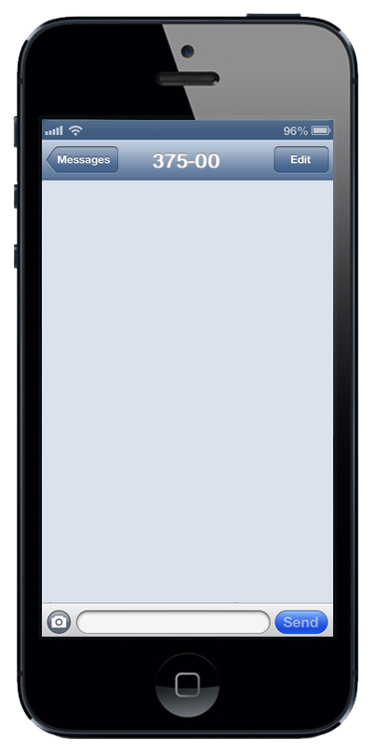

Which Pharmacist is on Queue duty?
4:17 PM
Aug 12, 2015, 07:15 AM
RX-Direct Direct>> note to pharmacist in charge. [John ] which registered RX Direct Rx Queue user is on duty today?
Please reply Active RPh by number for Sunspot Pharmacy
T. Johannsen
B. Christianson
A. Leggett
Logic:
Checks
The day of the week
Sent at the opening time of the pharmacy
Determine which RPh is active
Delivered
1
© 2015. Prepared for internal use only. This document contains information proprietary and confidential to Ingenious Mobility and is not to be disclosed in whole or in part without the express written consent of IMV.

Slide 70

Notify Rph of change in Queue
4:17 PM
Aug 12, 2015, 13:15 PM
RX Direct>> A new Rx request has posted and requires processing.
Log into the Queue Mgmt Portal now: www.Rx-direct.us/login
Logic:
Checks
Which RPh is active
The day of the week
The store is open
Checks against closing time in their store database
© 2015. Prepared for internal use only. This document contains information proprietary and confidential to Ingenious Mobility and is not to be disclosed in whole or in part without the express written consent of IMV.

Slide 71

Nudge RPh to check Queue
4:17 PM
April 21, 2015, 4:17 PM
Rx Direct>> A new Rx request has posted and requires processing. Log into the Queue Mgmt Portal now: www.rx-direct.us/login
Logic:
Checks against
RPh still signed in at pharmacy
No change in the status of the claim by another person at the pharmacy
The day of the week
closing time in their store database for that day
Rx Direct>> Its been 3hrs since a new Rx request has posted and requires processing. Log into the Queue Mgmt Portal now: www.Rx-direct.us/login
Yes
Delivered
Yes
© 2015. Prepared for internal use only. This document contains information proprietary and confidential to Ingenious Mobility and is not to be disclosed in whole or in part without the express written consent of IMV.

Slide 72
Pharmacy Alert: normal
RX-DIRECT
H O M E D E L I V E R Y
MY ALERTS
<< PREVIOUS NEXT >>
New Message 2 of 4
RECEIVED 2h 3m ago (4:16pm 01/13/2015)
SUBJECT:
ALERT – Confirmed Your Rx for has been processed
TRANSACTION DETAILS:
SERVICE REQUESTED: TRANSFER RX via APP
REQUEST MADE: 3:16pm 01/13/2016)
MEDICATION: PROPRANOLOL 20MG TABS
QUANTITY REQUESTED: 30
INSURANCE COPAY: $ 7.50
COMPLIANCE REWARD PTs (USED): 350 - 3.50 HANDING CHARGE: $ 2.25
PAYMENT CARD AUTHORIZED: $ 6.25
DELIVERY METHOD: 1-2 day
RX Number: 00-365699
ACTION :
Your Insurance allows a 30 day supply
If you prefer to NOT USE YOUR INSURANCE
and PAY CASH AMOUNT for a 100 Quantity
Thank you for your order from RX-DIRECT HOME DELIVERY
DO NOT USE INSURANCE
MARK READ / RETURN TO LIST
© 2016. Prepared for internal use only. This document contains information proprietary and confidential to Ingenious Mobility and is not to be disclosed in whole or in part without the express written consent of IMV.

Slide 73
Pharmacy Alert:
C-II Medication
RX-DIRECT
H O M E D E L I V E R Y
MY ALERTS
<< PREVIOUS NEXT >>
New Message 2 of 4
RECEIVED 2h 3m ago (4:16pm 01/13/2015)
SUBJECT:
ALERT (CRITICAL) : Unable to Fill Schedule II (C-II) Medication via Home Delivery (State PHARMACY LAW)
TRANSACTION DETAILS:
SERVICE REQUESTED: TRANSFER RX via APP
REQUEST MADE: 3:16pm 01/13/2016)
MEDICATION: OXYCODONE 40MG TABS
QUANTITY REQUESTED: 60
DEA SCHEDULE: C-II
ACTION :
Unfortunately, we are not able to fill your prescription, shown above. Please consult a local pharmacy in person for them to fill.
If law changes where we are able to fill this medication at a later date, we will notify you.
Please use our Drug Lookup Tool to search for other medications available through Rx-Direct.
MARK READ / RETURN TO LIST
© 2016. Prepared for internal use only. This document contains information proprietary and confidential to Ingenious Mobility and is not to be disclosed in whole or in part without the express written consent of IMV.

Slide 74
Pharmacy Alert:
Medication Not Stocked
RX-DIRECT
H O M E D E L I V E R Y
MY ALERTS
<< PREVIOUS NEXT >>
New Message 2 of 4
RECEIVED 2h 3m ago (4:16pm 01/13/2015)
SUBJECT:
ALERT: (CRITICAL) Unable to supply this currently at RX-DIRECT HOME DELIVERY
TRANSACTION DETAILS:
SERVICE REQUESTED: TRANSFER RX via APP
REQUEST MADE: 3:16pm 01/13/2016)
MEDICATION: REVLIMID 40MG TABS
QUANTITY: 30
ACTION :
Unfortunately, we are not able to fill your prescription, shown above. We apologize , but we do not currently stock some medications. Please consult a local pharmacy in person for them to fill.
At some point when we do stock this medication at a later date, we will notify you.
Please use our Drug Lookup Tool to search for other medications available through Rx-Direct.
MARK READ / RETURN TO LIST
© 2016. Prepared for internal use only. This document contains information proprietary and confidential to Ingenious Mobility and is not to be disclosed in whole or in part without the express written consent of IMV.

Slide 75
Pharmacy Alert:
REFILL TOO SOON
RX-DIRECT
H O M E D E L I V E R Y
MY ALERTS
<< PREVIOUS NEXT >>
New Message 2 of 4
RECEIVED 2h 3m ago (4:16pm 01/13/2015)
SUBJECT:
(CRITICAL) Insurance Did not Approve payment of Your Rx Order– “REFILL TOO SOON”
TRANSACTION DETAILS:
MEDICATION: LISINOPRIL 10MG
QUANTITY: (30)
NEXT REFILL DATE: 02/02-2016
ACTION REQUIRED (Three Options Available):
Wait until 02/02-2016 We will reschedule processing on the day Insurance allows refill
Call your insurance provider. This denial may be resolved by you if you need a vacation supply. Here is the customer service number below:
BCBS GA – Phone # 1-800-521-2227
After your conversation with the insurer rep ends satisfactorily, press the RETRY INSURANCE button below, and we will retry your claim.
3) Agree to pay CASH PRICE now. You can then submit your receipt to your insurer manually.
PAY CASH PRICE: $6.90 per 30 tablets
RETRY INSURANCE
FILL RX AS CASH
MARK READ / RETURN TO LIST
© 2016. Prepared for internal use only. This document contains information proprietary and confidential to Ingenious Mobility and is not to be disclosed in whole or in part without the express written consent of IMV.

Slide 76
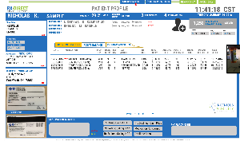
Pharmacy Alert:
Insurance
Claim Denied
RX-DIRECT
H O M E D E L I V E R Y
MY ALERTS
<< PREVIOUS NEXT >>
New Message 2 of 4
RECEIVED 2h 3m ago (4:16pm 01/13/2015)
SUBJECT:
(CRITICAL) Insurance did not approve payment of Your Rx Order
TRANSACTION DETAILS:
MEDICATION: OMEPRAZOLE 40MG
QUANTITY: 30 DAYS SUPPLY (30)
RX NUMBER: P013-18476293
ACTION REQUIRED (Two Options Available):
1) Call your insurance provider. This denial can frequently be resolved by you simply. Here is the customer service number below:
BCBSGA PPO – Phone # 800-555-5555
Once your conversation with the insurer rep ends satisfactorily, press the RETRY INSURANCE button below, and we will retry your claim.
2) Agree to pay CASH PRICE now. You can then submit your receipt to your insurer manually.
PAY CASH PRICE: $8.47 per 30 capsules
RETRY INSURANCE
FILL RX AS CASH
MARK READ / RETURN TO LIST
Pharmacy Portal
© 2016. Prepared for internal use only. This document contains information proprietary and confidential to Ingenious Mobility and is not to be disclosed in whole or in part without the express written consent of IMV.

Slide 77

PHARMACY QUEUE
SORT BY PATIENT
SORT BY PRESCRIBER
NEW RX ONLY
X-FER’s ONLY
5
11:41:18 CST
TUESDAY JANUARY 29 2016
You are currently logged in as:
Steven Vanser, R.Ph. (LOGOUT)
THE AVERAGE NUMBER OF PRESCRIPTIONS PROCESSED EACH DAY
42%
0h 41m
THE AVERAGE TIME IT TAKES YOUR PHARMACY TO PROCESS AN RX
37
THE % OF NEW PRESRIPTIONS
PROCESSED BY YOU THIS WEEK
Stats current as of 03/17/2016
@ 11:37:01 AM
PHARMACY PROFILE
2817 Filler Lane, #201
Hadwick, VT 05843
(802) 555-5555 - PH
(802) 555-2222 - FX
NEW / OPEN RX’s (9)
PENDING RX’s (6)
PROCESSED RX’s (238)
First
Last
Date of Birth (dd/mm/yyyy)
Primary Health Care Provider Name
RECEIVED PATIENT NAME PATIENT DOB RX NUMBER RX DRUG NAME STATUS
/ /
Robert T. Martin MD
EDIT
?
01/29/2016 @ 03:17 PM SAMPLE, NICOLAS 07/13/1981 P13-1394719 ATORVASTATIN 20MG NOT VIEWED
01/29/2016 @ 03:11 PM BLACK, KAREN D. 08/22/1977 P13-8461356 CITALOPRAM 20MG NOT VIEWED
01/29/2016 @ 02:42 PM FULLERTON, DAVID L. 01/02/1991 P13-8854621 IBOPROFEN 800MG NOT VIEWED
01/29/2016 @ 01:33 PM GRAVES, NATALIE O. 12/30/1947 P13-8761559 OMEPRAZOLE 40MG NOT VIEWED
01/29/2016 @ 11:37 AM JACKSON, FRANK P. 11/08/1959 P13-1332251 ATENOLOL 50MG OPEN BY OTHER USER (locked)
01/29/2016 @ 11:03 AM BURKETT, KENNETH A. 02/02/1970 P13-6002052 RANITIDINE 300MG OPEN BY OTHER USER (locked)
01/29/2016 @ 09:52 AM KELLER, EMMA J. 05/15/1988 P13-7418932 LISINOPRIL 5MG OPENED / STILL UNPROCESSED
01/29/2016 @ 08:01 AM JONES, BARBARA K. 01/27/1952 P13-2698432 METFORMIN 500MG OPENED / STILL UNPROCESSED 01/28/2016 @ 04:58 PM HARBIN, RORY T. 04/01/1939 P13-9900215 WARFARIN 2.5MG OPENED / STILL UNPROCESSED
01/29/2016 @ 02:42 PM FULLERTON, DAVID L. 01/02/1991 P13-8854621 IBOPROFEN 800MG PHARMACY ACTION NEEDED
01/29/2016 @ 01:33 PM GRAVES, NATALIE O. 12/30/1947 P13-8761559 OMEPRAZOLE 40MG PATIENT ACTION NEEDED
01/29/2016 @ 11:37 AM JACKSON, FRANK P. 11/08/1959 P13-1332251 ATENOLOL 50MG PHARMACY ACTION NEEDED
01/29/2016 @ 11:03 AM BURKETT, KENNETH A. 02/02/1970 P13-6002052 RANITIDINE 300MG PHARMACY ACTION NEEDED
01/29/2016 @ 09:52 AM KELLER, EMMA J. 05/15/1988 P13-7418932 LISINOPRIL 5MG PATIENT ACTION NEEDED
01/29/2016 @ 08:01 AM JONES, BARBARA K. 01/27/1952 P13-2698432 METFORMIN 500MG PATIENT ACTION NEEDED
USER PROFILES
OPEN RX STATUSES
OPENED / STILL UNPROCESSED
Prescription was previously viewed, but no action has been taken.
OPEN BY OTHER USER
Prescription is currently open by another user and cannot be viewed.
NOT VIEWED
Prescription has not been viewed by any user.
Pharmacists 2
Staff 5
Other 1
EDIT
Queue Overview
New / Open 9
Pending 6
Processed 238
REPORTS
RX QUEUE
REPORTS
PATIENT LOOKUP
PAGE << 1 of 1 >>
© 2016. Prepared for internal use only. This document contains information proprietary and confidential to Ingenious Mobility and is not to be disclosed in whole or in part without the express written consent of IMV.
Rx INSURANCE CARD RELATIONSHIP
Other Rx INSURANCE CARD
PAYMENT CARD
CYY Code
VISA ending in 1028
Expiration
03 - 17
* * *

Slide 78
PHARMACY QUEUE
SORT BY PATIENT
SORT BY PRESCRIBER
NEW RX ONLY
X-FER’s ONLY
5
11:41:18 CST
TUESDAY JANUARY 29 2016
You are currently logged in as:
Steven Vanser, R.Ph. (LOGOUT)
THE AVERAGE NUMBER OF PRESCRIPTIONS PROCESSED EACH DAY
42%
0h 41m
THE AVERAGE TIME IT TAKES YOUR PHARMACY TO PROCESS AN RX
37
THE % OF NEW PRESRIPTIONS
PROCESSED BY YOU THIS WEEK
Stats current as of 03/17/2016
@ 11:37:01 AM
PHARMACY PROFILE
2817 Filler Lane, #201
Hadwick, VT 05843
(802) 555-5555 - PH
(802) 555-2222 - FX
NEW / OPEN RX’s (9)
PENDING RX’s (6)
PROCESSED RX’s (238)
First
Last
Date of Birth (dd/mm/yyyy)
Primary Health Care Provider Name
RECEIVED PATIENT NAME PATIENT DOB RX NUMBER RX DRUG NAME STATUS
/ /
Robert T. Martin MD
EDIT
?
01/29/2016 @ 02:42 PM FULLERTON, DAVID L. 01/02/1991 P13-8854621 IBOPROFEN 800MG PHARMACY ACTION NEEDED
01/29/2016 @ 01:33 PM GRAVES, NATALIE O. 12/30/1947 P13-8761559 OMEPRAZOLE 40MG PATIENT ACTION NEEDED
01/29/2016 @ 11:37 AM JACKSON, FRANK P. 11/08/1959 P13-1332251 ATENOLOL 50MG PHARMACY ACTION NEEDED
01/29/2016 @ 11:03 AM BURKETT, KENNETH A. 02/02/1970 P13-6002052 RANITIDINE 300MG PHARMACY ACTION NEEDED
01/29/2016 @ 09:52 AM KELLER, EMMA J. 05/15/1988 P13-7418932 LISINOPRIL 5MG PATIENT ACTION NEEDED
01/29/2016 @ 08:01 AM JONES, BARBARA K. 01/27/1952 P13-2698432 METFORMIN 500MG PATIENT ACTION NEEDED
USER PROFILES
01/29/2016 @ 02:42 PM FULLERTON, DAVID L. 01/02/1991 P13-8854621 IBOPROFEN 800MG PATIENT ACTION NEEDED
01/29/2016 @ 01:33 PM GRAVES, NATALIE O. 12/30/1947 P13-8761559 OMEPRAZOLE 40MG PATIENT ACTION NEEDED
01/29/2016 @ 11:37 AM JACKSON, FRANK P. 11/08/1959 P13-1332251 ATENOLOL 50MG PHARMACY ACTION NEEDED
01/29/2016 @ 11:03 AM BURKETT, KENNETH A. 02/02/1970 P13-6002052 RANITIDINE 300MG PHARMACY ACTION NEEDED
01/29/2016 @ 09:52 AM KELLER, EMMA J. 05/15/1988 P13-7418932 LISINOPRIL 5MG PATIENT ACTION NEEDED
01/29/2016 @ 08:01 AM JONES, BARBARA K. 01/27/1952 P13-2698432 METFORMIN 500MG PATIENT ACTION NEEDED
!
Pharmacists 2
Staff 5
Other 1
!
EDIT
!
PHARMACY ACTION REQUIRED
INSURER PHONE NUMBER NECESSARY
Rx #: P13-8854621
Received: 01/29/2016 @ 02:42 PM
Patient: FULLERTON, DAVID L. (DOB: 01/02/1991)
Drug: Ibuprofen 800mg
The patient must be notified that a call to their insurer is necessary. Please review the patient’s insurance card (VIEW IMAGE) and enter the customer service number into the field below. This will be included in the message to the patient.
BCBSGA CUSTOMER SERVICE NUMBER:
Queue Overview
X
New / Open 9
Pending 6
Processed 238
REPORTS
RX QUEUE
Thank you!
Click anywhere to close
this window.
REPORTS
PATIENT LOOKUP
10-digit phone number
SUBMIT
8 8 8 – 2 2 2 – 5 5 5 5
PAGE << 1 of 1 >>
© 2016. Prepared for internal use only. This document contains information proprietary and confidential to Ingenious Mobility and is not to be disclosed in whole or in part without the express written consent of IMV.
Rx INSURANCE CARD RELATIONSHIP
Other Rx INSURANCE CARD
PAYMENT CARD
CYY Code
VISA ending in 1028
Expiration
03 - 17
* * *

Slide 79
PATIENT PROFILE
SORT BY PATIENT
SORT BY PRESCRIBER
NEW RX ONLY
X-FER’s ONLY
5
11:41:18 CST
NICHOLAS K.
SAMPLE
29
MEMBER SINCE
2
4
TUESDAY JANUARY 29 2016
11/16/ 1977
year old
MALE
09 2015
DEPENDENTS
PROGRAM Rx’s
ALLERGIES
DEPENDENT 1
NICHOLAS K. SAMPLE JR
(MALE) 12/12/2007 9 years old
SELECT
1,250
COMPLIANCE REWARD™ Points
SILVER
PENICILLIN
DEPENDENT 2
BRENDA M. SAMPLE
(FEMALE) 12/12/2007 9 years old
SELECT
First
Last
PEANUTS
DEPENDENT 3
Height
Date of Birth (dd/mm/yyyy)
MANGO
DEPENDENT 4
6 Ft 1 inch
Weight
BMI
Primary Health Care Provider Name
<edit>
215 LBS
20.2 %
/ /
Robert T. Martin MD
Mobile number
303-757-6965
ACTIVE MEDICATIONS
Back Up Phone Number
POINT EARNINGS
PAST MEDICATIONS
303-757-6965
DATE MEDICATION DISP DAYS REF LAST INS ORIG HANDLING POINTS TOTAL PT AMT NEXT
ADDRESS 1 : “NICK HOME”
QTY SUPP REM ACTION CODE COPAY FEE REDEEMED SALE COLLECTED REFILL
16320 E Hardwick Place
12/12/2015 ATORVASTATIN 20mg #60 30 2 TRANSFER IN COM $ 8.50 $2.75 300 $ 12.35 $ 5.25 01-07-2016
10-31-2015 GEMFIBROZIL 600mg #60 30 0 Rx Refill COM $ 11.50 $2.75 300 $ 19.90 $ 8.25 11-25-2015
09-30-2015 PROPRANOLOL 20mg #90 90 1 NEW RX RECEIVED CASH $ 11.50 $2.75 400 $ 22.75 $ 7.25 01-15-2016
09-30-2015 GEMFIBROZIL 600mg #60 30 0 NEW RX COM $ 11.50 $2.75 300 $ 19.90 $ 8.25 10-25-2015
APT 7-B
SOUTHLAKE TX 76092
<edit>
Patient Medication Scan
Submitted: 03/16/15 @ 11:32 CST
Last Viewed: 03/16/15 @ 16:02 CST
RETURN TO PRESCRIPTION LIST
ADDRESS 2 : “NICK WORK”
13 Olympic Ave
STE 130
Fort Worth TX 75851
<edit>
Pharmacy Notes
DID YOU KNOW…
We have developed standard messages for many of your common needs, accessible using the green buttons to the right. These messages are patient-specific and designed to save you time! (LEARN MORE)
Click anywhere to close
CARDHOLDER
PAGE << 1 of 1 >>
SEND PATIENT MESSAGE (SMS)
C-II Drug- Cannot Fill
Ins Declined- Cash Price
[PLACEHOLDER]
[PLACEHOLDER]
|
To communicate with the patient regarding
a prescription, please select one from the list above.
CANCEL
No Refills; Calling HCP
Medication Not Carried
[PLACEHOLDER]
[PLACEHOLDER]
SEND
Rx Expired; Calling HCP
Refill too Soon
[PLACEHOLDER]
[PLACEHOLDER]
© 2016. Prepared for internal use only. This document contains information proprietary and confidential to Ingenious Mobility and is not to be disclosed in whole or in part without the express written consent of IMV.
Rx INSURANCE CARD RELATIONSHIP
Other Rx INSURANCE CARD
PAYMENT CARD
CYY Code
VISA ending in 1028
Expiration
03 - 17
* * *

Slide 80
HOW THE IMV MAKES $
Program Sales Levy
15%-17% for prescriptions generated by participation
Pharmacy Marketing Support Services Fee
Each expansion pharmacy $ 5k / month + credit card fees
Handling Fee / Rx
$1.50- $3.00 each prescription
Recurring Revenue
Upsell patients to memberships to reduce the handling fee burden
Therapeutic Sponsorships
PhRMA / approved marketers for data
Referral Fees
Clinical trials , laboratory tests
Credit Card processing
As volume grows- efficiencies are created
© 2016. Prepared for internal use only. This document contains information proprietary and confidential to Ingenious Mobility and is not to be disclosed in whole or in part without the express written consent of IMV.

Slide 81
Settings Screen
RX-DIRECT
H O M E D E L I V E R Y
SETTINGS
Tapping settings on the slide menu causes the slide menu to expand to fill screen.
APP SOUNDS
ON
OFF
PIN-SECURITY
ON
OFF
NOTIFICATIONS
ON
OFF
Reward Points Earned!
By completing the registration process, you earned 37 compliance reward points. Learn more.
37
SAVE SETTINGS
© 2016. Prepared for internal use only. This document contains information proprietary and confidential to Ingenious Mobility and is not to be disclosed in whole or in part without the express written consent of IMV.

Slide 82
PIN SECURITY
RX-DIRECT
H O M E D E L I V E R Y
SETTINGS
APP SOUNDS
ON
OFF
PIN-SECURITY
ON
OFF
If user turns on PIN SECURITY, the PIN prompt appears.
NOTIFICATIONS
ON
OFF
PLEASE ENTER A 4-DIGIT PIN
7 | 8 | 9
4 | 5 | 6
1 | 2 | 3
0 | ENTER
Reward Points Earned!
By completing the registration process, you earned 37 compliance reward points. Learn more.
37
SAVE SETTINGS
© 2016. Prepared for internal use only. This document contains information proprietary and confidential to Ingenious Mobility and is not to be disclosed in whole or in part without the express written consent of IMV.

Slide 83
NOTIFICATIONS
RX-DIRECT
H O M E D E L I V E R Y
SETTINGS
APP SOUNDS
ON
OFF
PIN-SECURITY
ON
OFF
If user attempts to turn off notifications, the message below appears.
NOTIFICATIONS
ON
OFF
Are you sure?
Turning off notifications will prevent you from receiving updates on your medications and reward opportunities.
YES, turn them off!
Not recommended
NO, keep them on!
Reward Points Earned!
By completing the registration process, you earned 37 compliance reward points. Learn more.
37
SAVE SETTINGS
© 2016. Prepared for internal use only. This document contains information proprietary and confidential to Ingenious Mobility and is not to be disclosed in whole or in part without the express written consent of IMV.

Slide 84










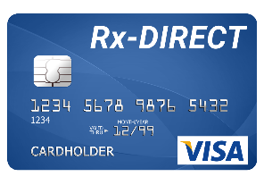
COMPLIANCE REWARDS ™
Redeemable for purchases
Redeemable for purchases and /or cash at RX-DIRECT private network es
Earning points for advancing their health, compliance & education
+ 1850 Points
Patient
+300 pts
Patient Bio Metric Activity
+150 pts
Patient Compliance
over 70%
Remains
Engaged
+300 pts
Pulse Reading
P
A
T
I
E
N
T
Refill on Time
+200 pts
Survey participation
Education
+200 pts
+300 pts
+400 pts
APPLICATION
© 2016. Prepared for internal use only. This document contains information proprietary and confidential to Ingenious Mobility and is not to be disclosed in whole or in part without the express written consent of IMV.

Slide 85


Slide 86
DRUG LOOK UP
RX-DIRECT
DRUG LOOK UP
H O M E D E L I V E R Y
H O M E D E L I V E R Y
o
Pr
Propranolol
TYPE MEDICATION NAME
Prednisone
Pravastatin (Pravachol)
Propranolol
Promethazine
Propranolol
Promethazine
POPULAR MEDICATIONS
Rx’s by TREATMENT Category
LIPITOR
atorvastatin calcium
AMBIEN
zolpidem
XANAX
alprazolam
ULTRAM
tramadol
NEURONTIN
gabapentin
SYNTHROID
levothyroxine
ZESTRIL
lisinopril
GLUCOPHAGE
metformin
MOBIC
meloxicam
CELEXA
citalopram
more
© 2016. Prepared for internal use only. This document contains information proprietary and confidential to Ingenious Mobility and is not to be disclosed in whole or in part without the express written consent of IMV.

Slide 87
CHECK CASH PRICE
COMPLIANCE REWARDS™
RX-DIRECT
DRUG LOOK UP
H O M E D E L I V E R Y
H O M E D E L I V E R Y
Propranolol
RX-DIRECT
10mg
20mg t
40mg
SELECT QUANITY
H O M E D E L I V E R Y
1
10
20
28
30
40
60
90
100
120
60 pills
PROPRANOLOL 20MG
$ 9.44
REDEEMED COMPLIANCE REWARDS™ BALANCE
YOUR RX PRICE
$ 6.29
Enter a custom qty
Qty
SET
RETAIL PHARMACY PRICE ESTIMATES
$14.19 to $26.96
BEGIN RX TRANSFER TO
SAVE SEARCH
© 2016. Prepared for internal use only. This document contains information proprietary and confidential to Ingenious Mobility and is not to be disclosed in whole or in part without the express written consent of IMV.

Slide 88
TRANSFER
FROM PRICE HISTORY
RX-DIRECT
SAVED DRUG SEARCHS
H O M E D E L I V E R Y
2 SAVED SEARCHES
+
ADD ANOTHER SEARCH
RECENT SEARCHES CLEAR ALL
2-15-2016
PROPRANOLOL TAB
Strength: 20mg
Qty # 60
Cash Pay Home Delivery Price $9.44
2-10-2016
Warfarin (COUMADIN generic)
Strength: 2mg
Qty # 60
Cash Pay Home Delivery Price $16.35
IS PROPRANOLOL 20mg A CURRENT RX YOU HAVE WITH A LABEL FROM ANOTHER PHARMACY?
CLEAR
REPRICE
START Rx TRANSFER
NO
YES
CLEAR
REPRICE
START Rx TRANSFER
HOME
© 2016. Prepared for internal use only. This document contains information proprietary and confidential to Ingenious Mobility and is not to be disclosed in whole or in part without the express written consent of IMV.

Slide 89
INSURANCE or CASH
COMPLIANCE REWARDS™
RX-DIRECT
INSURANCE / CASH PAY
H O M E D E L I V E R Y
H O M E D E L I V E R Y
RX-DIRECT
H O M E D E L I V E R Y
60 pills
PROPRANOLOL 20MG
$ 9.44
REDEEMED COMPLIANCE REWARDS™ BALANCE
YOUR RX PRICE
$ 6.29
CASH PAY
USE RX INSURANCE
TRANSFER NOW
© 2016. Prepared for internal use only. This document contains information proprietary and confidential to Ingenious Mobility and is not to be disclosed in whole or in part without the express written consent of IMV.

Slide 90
CURRENT RX?
RX-DIRECT
REQUEST A RX
H O M E D E L I V E R Y
Prescriptions may be obtained by Rx-Direct one of 3 ways
1
Your doctor may call in a prescription for you : 817-274-8200
2
Your doctor’s office may fax your prescription: 817-274-8205
3
Your doctor’s office may ePrescribe your prescription: RX-DIRECT HOME DELIVERY ARLINGTON, TX
HOME
© 2016. Prepared for internal use only. This document contains information proprietary and confidential to Ingenious Mobility and is not to be disclosed in whole or in part without the express written consent of IMV.

Slide 91
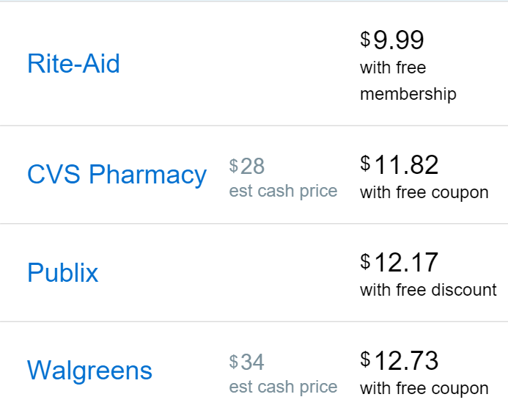
RX LOOK UP
RX-DIRECT
SEARCH MEDICATION
H O M E D E L I V E R Y
H O M E D E L I V E R Y
Propranolol
Pr
o
Prednisone
Pravastatin (Pravachol)
Propranolol
Promethazine
Propranolol
Promethazine
RX-DIRECT
10mg
20mg t
40mg
SELECT QUANITY
H O M E D E L I V E R Y
1
10
20
28
30
40
60
90
100
120
60 pills
PROPRANOLOL 20MG
$ 9.44
REDEEMED COMPLIANCE REWARDS™ BALANCE
YOUR RX PRICE
$ 6.29
CHAIN PHARMACY PRICE ESTIMATES
Enter a custom qty
$ 14.96 to $ 26.86
SET
Qty
REQUEST TRANSFER RX
© 2016. Prepared for internal use only. This document contains information proprietary and confidential to Ingenious Mobility and is not to be disclosed in whole or in part without the express written consent of IMV.

Slide 92
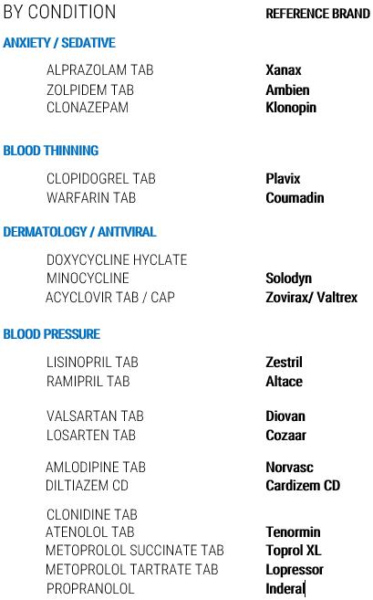
DRUG LOOK UP by condition
RX-DIRECT
DRUG LOOK UP
H O M E D E L I V E R Y
H O M E D E L I V E R Y
TYPE YOUR MEDICATION NAME
POPULAR MEDICATIONS
Rx’s by TREATMENT Category
REFERENCE BRAND(S)
© 2016. Prepared for internal use only. This document contains information proprietary and confidential to Ingenious Mobility and is not to be disclosed in whole or in part without the express written consent of IMV.

Slide 93
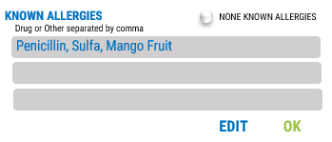
EDIT MY PROFILE
ALLERGIES
RX-DIRECT
EDIT MY PROFILE
H O M E D E L I V E R Y
EDIT MY PROFILE
BURKETT DOB: 11-16-1965 (M)
KEN
email
ken@burkett.mobi
Mobile number
Back Up Phone Number
303-757-6965
303-757-6965
ALLERGIES
EDIT [ + ]
DELIVERY ADDRESS (2)
EDIT [ + ]
DEPENDENTS (1)
EDIT [ + ]
BILLING ADDRESS
EDIT [ + ]
RX INSURANCE CARD (1)
EDIT [ + ]
PAYMENT INFORMATION
EDIT [ + ]
Copyright © 2016 Ingenious Mobility Ventures
© 2016. Prepared for internal use only. This document contains information proprietary and confidential to Ingenious Mobility and is not to be disclosed in whole or in part without the express written consent of IMV.

Slide 94
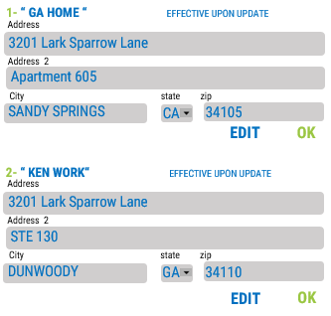
EDIT MY PROFILE
DELIVERY
RX-DIRECT
EDIT MY PROFILE
H O M E D E L I V E R Y
EDIT MY PROFILE
BURKETT DOB: 11-16-1965 (M)
KEN
email
ken@burkett.mobi
Mobile number
Back Up Phone Number
303-757-6965
303-757-6965
ALLERGIES
EDIT [ + ]
DELIVERY ADDRESS (2)
EDIT [ + ]
DEPENDENTS (1)
EDIT [ + ]
BILLING ADDRESS
EDIT [ + ]
RX INSURANCE CARD (1)
EDIT [ + ]
PAYMENT INFORMATION
EDIT [ + ]
Copyright © 2016 Ingenious Mobility Ventures
© 2016. Prepared for internal use only. This document contains information proprietary and confidential to Ingenious Mobility and is not to be disclosed in whole or in part without the express written consent of IMV.

Slide 95
EDIT MY PROFILE
DEPENDENTS
RX-DIRECT
EDIT MY PROFILE
H O M E D E L I V E R Y
EDIT MY PROFILE
BURKETT DOB: 11-16-1965 (M)
KEN
email
ken@burkett.mobi
Mobile number
Back Up Phone Number
303-757-6965
303-757-6965
ALLERGIES
EDIT [ + ]
DELIVERY ADDRESS (2)
EDIT [ + ]
DEPENDENTS (1)
EDIT [ + ]
1- Xander
Burkett
EDIT [ + ]
BILLING ADDRESS
DOB: 5-19-2015 (M)
ALLERGIES:
Shellfish, Iodine
EDIT [ + ]
RX INSURANCE CARD (1)
SHIPPING ADDRESS
Same as Account Holder
EDIT [ + ]
PAYMENT INFORMATION
RX INSURANCE
Same as Account Holder
“CHILD” -03
PAYMENT INFORMATION
Same as Account Holder
EDIT OK
Copyright © 2016 Ingenious Mobility Ventures
© 2016. Prepared for internal use only. This document contains information proprietary and confidential to Ingenious Mobility and is not to be disclosed in whole or in part without the express written consent of IMV.

Slide 96
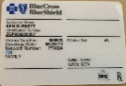
EDIT MY PROFILE
RX INSURANCE
RX-DIRECT
EDIT MY PROFILE
H O M E D E L I V E R Y
EDIT MY PROFILE
BURKETT DOB: 11-16-1965 (M)
KEN
email
ken@burkett.mobi
Mobile number
Back Up Phone Number
303-757-6965
303-757-6965
ALLERGIES
EDIT [ + ]
DELIVERY ADDRESS (2)
EDIT [ + ]
DEPENDENTS (1)
EDIT [ + ]
BILLING ADDRESS
EDIT [ + ]
RX INSURANCE CARD (1)
EDIT [ + ]
PAYMENT INFORMATION
EDIT [ + ]
RELATIONSHIP
Cardholder
Spouse
Child
Other Dependent
Copyright © 2016 Ingenious Mobility Ventures
© 2016. Prepared for internal use only. This document contains information proprietary and confidential to Ingenious Mobility and is not to be disclosed in whole or in part without the express written consent of IMV.

Slide 97


MY ALERTS v2
RX-DIRECT
H O M E D E L I V E R Y
MY ALERTS
6
MY ALERTS
6
MY ALERTS
ALL MESSAGES
3 CRITICAL
YOUR ALERTS
3 CRITICAL
YOUR ALERTS
3 CRITICAL
CRITICAL (3)
NEW (3)
READ (6)
CRITICAL (2)
NEW (3)
READ (6)
CRITICAL (2)
NEW (3)
READ (6)
UNREAD - RECEIVED 2h 3m ago
UNREAD - RECEIVED 2h 3m ago
READ - RECEIVED 3d ago
YOUR RX IS OUT OF REFILLS: OMEPRA..
WARFARIN MED. GUIDE – FDA REQUI..
ACTIVITY: PULSE READ (200pts) ATENO..
UNREAD - RECEIVED 2h 17m ago
UNREAD - RECEIVED 2h 17m ago
READ - RECEIVED 4d ago
INSURANCE CARD OUT OF DATE
WARFARIN Rx SHIPPED; $1.90 CHARG..
ACTIVITY: BMI READ (200pts) ATENOLO..
UNREAD - RECEIVED 1d ago
UNREAD - RECEIVED 1d ago
READ - RECEIVED 4d ago
PAYMENT METHOD IS NOT VALID
RX TRANSFER COMPLETED (150..
RX ARRIVED: ATENOLOL 50 MG; NOW P..
READ - RECEIVED 7d ago
PATIENT EDUCATION (350pts) BLOOD P..
READ - RECEIVED 2w ago
PATIENT EDUCATION (150pts)
READ - RECEIVED 4d ago
ACTIVITY: BP READ (200pts) ATENOLOL..
© 2016. Prepared for internal use only. This document contains information proprietary and confidential to Ingenious Mobility and is not to be disclosed in whole or in part without the express written consent of IMV.

Slide 98
Insurance Card
Out of Date
RX-DIRECT
H O M E D E L I V E R Y
MY ALERTS
INSURANCE COVERAGE
INSURANCE CARD EXPIRED
2 of 9 (3 new)
<< PREVIOUS NEXT >>
RECEIVED 2h 3m ago (4:16pm 01/13/2015)
SUBJECT:
Insurance Card out of Date
MESSAGE:
The insurance card we have on file is out of date.
ACTION:
Please use the button below to update your insurance card and ensure you continue to receive the best prices on your medications.
Typing is overrated.
Please use the buttons below to scan the front and back of your prescription insurance card.
UPDATE INSURANCE CARD NOW
Relationship to cardholder:
SELF
CHILD
SPOUSE
OTHER DEPENDENT
MARK READ / RETURN TO LIST
SAVE AND UPDATE
© 2016. Prepared for internal use only. This document contains information proprietary and confidential to Ingenious Mobility and is not to be disclosed in whole or in part without the express written consent of IMV.

Slide 99
Payment
Method
Invalid
RX-DIRECT
H O M E D E L I V E R Y
MY ALERTS
PAYMENT INFORMATION
PAYMENT CARD EXPIRY
2 of 9 (3 new)
<< PREVIOUS NEXT >>
RECEIVED 2h 3m ago (4:16pm 01/13/2015)
SUBJECT:
Payment Card Method is no longer valid
MESSAGE:
The payment method we have on file has expired or is invalid. We will not be able to process any medication orders until we have a correct payment method on file.
Please update your payment method using the button below.
We’d do this for free if we could.
But until then, we’ll need payment information for your medication costs.
Cardholder Name
Ken Burkett
Card number
4413 5188 2212 0665
Expires MMYY
CVV
UPDATE PAYMENT METHOD NOW
04 20
123
MARK READ / RETURN TO LIST
SAVE AND UPDATE
© 2016. Prepared for internal use only. This document contains information proprietary and confidential to Ingenious Mobility and is not to be disclosed in whole or in part without the express written consent of IMV.

Slide 100
Pharmacy Alert:
Insurance
Claim Denied
RX-DIRECT
H O M E D E L I V E R Y
DESIGN LANGUAGE UPDATE:
Three key sections of message are only text using large (10pt) font.
Buttons need to match. The design of them can change, but there should be this consistency across all message.
Bold formatting used in a consistent nature.
Critical “header bar” removed / critical indication added to subject.
Next / Previous buttons made blue to be consistent with app interactability.
Entire message page background made gray.
MY ALERTS
<< PREVIOUS NEXT >>
New Message 2 of 4
RECEIVED 2h 3m ago (4:16pm 01/13/2015)
SUBJECT:
(CRITICAL) Insurance Did not Approve payment of Your Rx Order
TRANSACTION DETAILS:
MEDICATION: OMEPRAZOLE 40MG
QUANTITY: 30 DAYS SUPPLY (30)
RX NUMBER: P013-18476293
ACTION REQUIRED (Two Options Available):
1) Call your insurance provider. This denial can frequently be resolved by you simply. Here is the customer service number below:
BCBSGA PPO – Phone # 800-555-5555
Once your conversation with the insurer rep ends satisfactorily, press the RETRY INSURANCE button below, and we will retry your claim.
2) Agree to pay CASH PRICE now. You can then submit your receipt to your insurer manually.
PAY CASH PRICE: $8.47 per 30 capsules
RETRY INSURANCE
FILL RX AS CASH
MARK READ / RETURN TO LIST
Pharmacy Portal
© 2016. Prepared for internal use only. This document contains information proprietary and confidential to Ingenious Mobility and is not to be disclosed in whole or in part without the express written consent of IMV.

Slide 101
Pharmacy Alert:
C-II Medication
RX-DIRECT
H O M E D E L I V E R Y
MY ALERTS
CANNOT FILL CONTROLLED MEDICATION
2 of 9 (3 new)
<< PREVIOUS NEXT >>
RECEIVED 2h 3m ago (4:16pm 01/13/2015)
SUBJECT:
ALERT: Unable to Fill Schedule II Medication via Home Delivery (State PHARMACY LAW)
TRANSACTION DETAILS:
MEDICATION: OXYCODONE 40MG TABS
DEA SCHEDULE: C-II
QUANTITY: 30 DAYS SUPPLY: 30
RX NUMBER: 18476293
ACTION :
Unfortunately, we are not able to fill your prescription, shown above. Please consult a local pharmacy in person for them to fill.
If law changes where we are able to fill this medication at a later date, we will notify you.
Please use our Drug Lookup Tool to search for other medications available through Rx-Direct.
DRUG LOOKUP TOOL
MARK READ / RETURN TO LIST
Pharmacy Portal
© 2016. Prepared for internal use only. This document contains information proprietary and confidential to Ingenious Mobility and is not to be disclosed in whole or in part without the express written consent of IMV.

Slide 102
Pharmacy Alert:
BRAND / DOSAGE FORM NOT STOCKED
RX-DIRECT
H O M E D E L I V E R Y
MY ALERTS
MEDICATION NOT STOCKED
2 of 9 (3 new)
<< PREVIOUS NEXT >>
RECEIVED 2h 3m ago (4:16pm 01/13/2015)
SUBJECT:
ALERT: Unable to supply this currently at RX-DIRECT HOME DELIVERY
TRANSACTION DETAILS:
MEDICATION: REVLIMID 40MG TABS
QUANTITY: 30 DAYS SUPPLY: 30
RX NUMBER: 18476293
ACTION :
Unfortunately, we are not able to fill your prescription, shown above. We apologize , but we do not currently stock some medications. Please consult a local pharmacy in person for them to fill.
At some point when we do stock this medication at a later date, we will notify you.
Please use our Drug Lookup Tool to search for other medications available through Rx-Direct.
DRUG LOOKUP TOOL
MARK READ / RETURN TO LIST
Pharmacy Portal
© 2016. Prepared for internal use only. This document contains information proprietary and confidential to Ingenious Mobility and is not to be disclosed in whole or in part without the express written consent of IMV.

Slide 103
Pharmacy Alert:
No Refills
Remaining
RX-DIRECT
H O M E D E L I V E R Y
MY ALERTS
NO REFILLS REMAINING
2 of 9 (3 new)
<< PREVIOUS NEXT >>
RECEIVED 2h 3m ago (4:16pm 01/13/2015)
SUBJECT:
ALERT: No Refills Remaining. State Pharmacy law requires contacting prescriber to authorize additional refills
TRANSACTION DETAILS:
MEDICATION: CITALOPRAM 40MG TABS
QUANTITY: 90
DAYS SUPPLY: 90
RX NUMBER: 18492738
ACTION:
We are currently contacting your prescriber (J. EDWARDS, 770-123-5555) to request additional refills for this prescription and will notify you once they respond.
MARK READ / RETURN TO LIST
Pharmacy Portal
© 2016. Prepared for internal use only. This document contains information proprietary and confidential to Ingenious Mobility and is not to be disclosed in whole or in part without the express written consent of IMV.

Slide 104
Pharmacy Alert:
Rx Expired
RX-DIRECT
H O M E D E L I V E R Y
MY ALERTS
RX EXPIRED
2 of 9 (3 new)
<< PREVIOUS NEXT >>
RECEIVED 2h 3m ago (4:16pm 01/13/2015)
SUBJECT:
ALERT: Rx Expired. State Pharmacy law permits 12 month prescription for most drugs and 6 months for Controlled Drugs from the original date of issue.
TRANSACTION DETAILS:
MEDICATION: OMEPRAZOLE 40MG TABS
QUANTITY: 90 DAYS SUPPLY: 90
RX NUMBER: 5491654
ORIG DATE WRITTEN: 05-15-2014
ACTION:
We recognize this is a maintenance Rx for most patients and are currently contacting your prescriber (J. EDWARDS, 770-123-5555) to request a new prescription and will notify you once the prescriber issues the New Rx or if anything changes.
MARK READ / RETURN TO LIST
Pharmacy Portal
© 2016. Prepared for internal use only. This document contains information proprietary and confidential to Ingenious Mobility and is not to be disclosed in whole or in part without the express written consent of IMV.

Slide 105
Pharmacy Alert:
Medication Not
Profitable
RX-DIRECT
H O M E D E L I V E R Y
MY ALERTS
MEDICATION NOT CURRENTLY AVAILABLE
2 of 9 (3 new)
<< PREVIOUS NEXT >>
RECEIVED 2h 3m ago (4:16pm 01/13/2015)
SUBJECT:
ALERT: Medication Not Currently Available
TRANSACTION DETAILS:
MEDICATION: SULFASALAZINE 500MG TABS
QUANTITY: 120 DAYS SUPPLY: 60
RX NUMBER: 5698165
ACTION:
The medication is out of stock / currently unavailable through this program. We recommend making arrangements with a another pharmacy for this product.
We are sorry for this inconvenience but will notify you once our ability to supply this drug changes at a later date.
MARK READ / RETURN TO LIST
Pharmacy Portal
© 2016. Prepared for internal use only. This document contains information proprietary and confidential to Ingenious Mobility and is not to be disclosed in whole or in part without the express written consent of IMV.

Slide 106
Pharmacy Alert:
Too Soon to Refill
RX-DIRECT
H O M E D E L I V E R Y
MY ALERTS
TOO SOON - NOT YET REFILLABLE
2 of 9 (3 new)
<< PREVIOUS NEXT >>
RECEIVED 2h 3m ago (4:16pm 01/13/2015)
SUBJECT:
ALERT: Insurer deems it “too soon to refill” your medication
TRANSACTION DETAILS:
MEDICATION: OMEPRAZOLE 40MG TABS
QUANTITY: 60 DAYS SUPPLY: 60
INSURER:
ACTION:
Two Options Available
1) Call your insurance provider. This can be frequently be resolved by you requesting a vacation supply. Here is the customer service number below:
BCBSGA PPO 800-555-5555
Once your conversation with the insurer rep ends satisfactorily press we will retry.
2) Agree to pay CASH PRICE now; submit receipt to Insurer manually
PAY CASH PRICE: $8.47 per 30 capsules
RE-TRY INS
FILL AS CASH
MARK READ / RETURN TO LIST
Pharmacy Portal
© 2016. Prepared for internal use only. This document contains information proprietary and confidential to Ingenious Mobility and is not to be disclosed in whole or in part without the express written consent of IMV.

Slide 107

COMPLIANCE REWARDS™
BALANCE
RX-DIRECT
ALENDRONATE
H O M E D E L I V E R Y
MY REWARDS
POINTS BALANCE
YOUR REWARD POINTS
350 AVAILABLE / 1075 LIFETIME
Current as of 01/13/2016*
<< PREVIOUS NEXT >>
ALENDRONATE 70MG TAB
RX: HQ2568999 DAYS SUPPLY: 30
In Program Since: 12-19-2015
ACTIVE IN PROGRAM 100 pts
REFILL 50 pts
COMPLIANCE CLUB BONUS 25 pts
175 Pts
ALENDRONATE 70MG: 175 pts
WARFARIN 450 pts
ALLOPURINOL 250 pts
METFORMIN 200 pts
BONUS POINT OPPORTUNITIES
SHARE RX-DIRECT WITH A FRIEND + 300 pts
TRANSFER RX TO RX-DIRECT + 300 pts
HEALTH EDUCATION + 400 pts
SUBMIT BLOOD GLUCOSE RESULT + 50 pts
GO TO STORE!
SUBMIT BMI READING + 50 pts
RETURN TO LIST
GO TO STORE!
© 2016. Prepared for internal use only. This document contains information proprietary and confidential to Ingenious Mobility and is not to be disclosed in whole or in part without the express written consent of IMV.

Slide 108

Rewards
Store
CASH REWARDS
REWARDS STORE
POINTS BALANCE
YOUR REWARD POINTS
350 AVAILABLE / 1075 LIFETIME
Current as of 12/13/2015*
YOUR SELECTED REWARD
CASH CARD - $20
Cash card will be a prepaid VISA, sent to the shipping address currently on file (8 TRENT DR).
2,500 pts
Search Reward Catalog
Available Rewards
Required for Purchase
Rewards after Purchase
3,200
2,500
700
CASH REWARDS
PURCHASE
2,500 pts
CASH CARD - $20
5,500 pts
SIMILAR ITEMS
CASH CARD - $50
CASH CARD - $10
10,500 pts
CASH CARD - $100
CASH CARD - $20
Over-the-Counter Medications
Bandages / Wound Care
Beauty Products
Vitamins / Supplements
RETURN TO STORE
© 2016. Prepared for internal use only. This document contains information proprietary and confidential to Ingenious Mobility and is not to be disclosed in whole or in part without the express written consent of IMV.

Slide 109
MY RX ORDERS
RX-DIRECT
MY ORDERS
Tracking Details
H O M E D E L I V E R Y
FILLED RX HISTORY
Current as of 01/13/2016*
YOUR ORDER
#8461234 TRACKING DETAILS
ALEDRONDATE 70MG TAB
Latest update: Tuesday, November 8th
4:21 AM | Package arrived at carrier facility Rome, GA
2:02 AM | Package left carrier facility Atlanta, Georgia
Monday, November 9th
6:47 PM | Order left RxDirect warehouse Dallas, Texas
11:13 AM | Package info received by carrier
10:11 AM | Package label created
ORDER NUMBER: 8461234
ORDER DATE: 11/21/2015
ORDER STATUS: SHIPPED
EXPECTED DELIVERY: 11/24/2015
LAST INSURANCE COPAY: $15.00
AWARD POINTS USED: $ 6.00 (-)
PAYMENT COLLECTED (VISA 3921): $ 8.50
SHIPPED VIA UPS (Tracking #1z3920482039104)
WARFARIN 5MG TAB
ALLOPURINOL 300MG TAB
METFORMIN 850MG TAB
VIEW ORDER RECEIPT
VIEW TRACKING DETAILS
CARRIER: UPS
METHOD: Ground (2-3 day)
Carrier Tracking #: 1Z3920482039104
RETURN TO MY ORDERS
© 2016. Prepared for internal use only. This document contains information proprietary and confidential to Ingenious Mobility and is not to be disclosed in whole or in part without the express written consent of IMV.

Slide 110
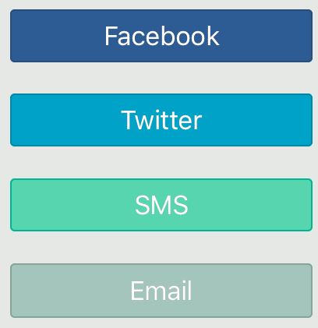
SHARE WITH OTHERS
RX-DIRECT
SHARE WITH OTHERS
H O M E D E L I V E R Y
SHARE Rx-DIRECT WITH A FRIEND!
Each friend who signs up will net you 50 points!
Sharing is caring. Give someone you know the gift of lower prices and greater convenience, all while earning bonus points for doing a good thing.
Facebook “Handle”
SnookieB1
Hey!
I found the coolest app called Rx-Direct that saves me money on my prescription pills and a ton of the hassle with my prescriptions at a local pharmacy.
They accept most all insurance plans, give rewards that can be redeemed for cash towards store purchases, and they deliver to me!
Your Sharing Link:
http://rx-direct.us/share/19328da
COPY
© 2016. Prepared for internal use only. This document contains information proprietary and confidential to Ingenious Mobility and is not to be disclosed in whole or in part without the express written consent of IMV.

Slide 111
Survey
RX-DIRECT
BONUS POINTS
H O M E D E L I V E R Y
SUBMIT YOUR BLOOD GLUCOSE READING!
Submitting your reading will earn you 50 points!
One or more of the medications you are taking may or may not have an impact on your blood glucose readings. Anonymously submitting a reading will help ensure proper care for patients around the world (how this helps).
This submission page can be reached from two screens:
My Rewards
Under “BONUS POINT OPPORTUNITIES”
My Alerts
From point opportunity message
Blood Glucose mg/dl
Blood Glucose Reading (mg/dL)
110
Time
AM
Time of Reading (hh:mm)
7:30
PM
How this information is used
Our privacy protection policy
SUBMIT GLUCOSE READING
© 2016. Prepared for internal use only. This document contains information proprietary and confidential to Ingenious Mobility and is not to be disclosed in whole or in part without the express written consent of IMV.

Slide 112
Survey
RX-DIRECT
BONUS POINTS
H O M E D E L I V E R Y
ACTIVITY RECEIVED!
Your participation has earned you 50 points!
50
VIEW MY REWARDS
RETURN TO MAIN MENU
© 2016. Prepared for internal use only. This document contains information proprietary and confidential to Ingenious Mobility and is not to be disclosed in whole or in part without the express written consent of IMV.

Slide 113
Survey
RX-DIRECT
SURVEY
H O M E D E L I V E R Y
TELL US ABOUT YOUR EXPERIENCE!
Completing this survey will earn you 450 points!
SHIPPING OF RX TO MY ADDRESS
RIGHT ON TIME; NO ISSUES
SOMETHING WASN’T RIGHT
PRODUCT CONDITION
PERFECT; NO ISSUES
SOMETHING WASN’T RIGHT
QUALITY OF PACKAGING
GOOD; EASY TO OPEN
SOMETHING WASN’T RIGHT
SUBMIT SURVEY
© 2016. Prepared for internal use only. This document contains information proprietary and confidential to Ingenious Mobility and is not to be disclosed in whole or in part without the express written consent of IMV.

Slide 114
Thank You

Slide 115
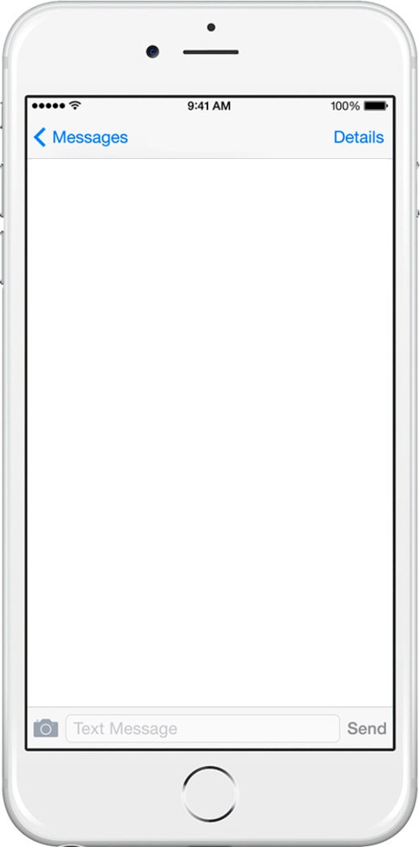
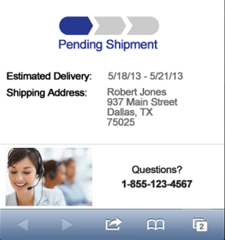
Up to the moment Order status
RX-DIRECT
RX-DIRECT
H O M E D E L I V E R Y
H O M E D E L I V E R Y
Status
< END DEMO >
Order # 204568A :
Shipped
1/8/15- 1/12/15
TRACKING: TXMD4598455TD
Details
12/28/2015 Rx obtained from University Clinic
12/29/2015 Rx # 845635 fulfilled Pharmacy HQ SD
01/02/2015 Parcel # 845635 shipped: Sioux Falls SD
Yes
View Terms & Conditions | Privacy Policy | Espanol ? | Return Policy
© 2016. Prepared for internal use only. This document contains information proprietary and confidential and is not to be disclosed in whole or in part without the express written consent .

Slide 116
Dependent:
AGE CHECK
Patient Info
ADD NEW FAMILY MEMBER
Patient Age over 18
Unfortunately, we require anyone 18 or older to register with their own Rx-Direct™ account.
Please Download the application from their mobile device.
For more information, please see our eligibility conditions.
Tap anywhere to close
Just need a few tidbits to add a dependent to your account
Date of Birth MM/DD/YYYY
Male
Date of Birth DD/MM/YYYY
Male
01 / 15 / 1998
CONTINUE

Slide 117
Dependent under 18
Patient Info
ADD FAMILY MEMBER
We just need a few bits of information for your family member.
Date of Birth MM/DD/YYYY
Date of Birth DD/MM/YYYY
Male
05 / 19 / 2013
Male
First Name
Last Name
FIRST NAME
LAST NAME
Xander
Burkett
Do they have any food or medication allergies?
YES
Why we need this.
YES
NO
Dependent Allergies
list your allergies here separate by commas
Iodine, shellfish
DELIVERY INFORMATION

Slide 118
Dependent Delivery Address
DEPENDENT Delivery Address
Please provide us with the address you’d like your Rxs delivered.
USE THE DELIVERY ADDRESS AS MINE
Street address
APT
82 Sycamore Lane SE
7-B
City
ZIP
Peachtree City
30339
Address Alias
HOME
WORK
GA Home
ADD ANOTHER ADDRESS FOR DELIVERY
EXPEDITED DELIVERY ?
Same day (+ 8.00) only in participating areas)
1-2 days (+ 2.50 National)
You can change your Delivery option at any time.
2-3 days (+ 1.50 National)
CONTINUE

Slide 119
Invalid Street Address
Delivery Address
Address not serviceable by law.
Unfortunately, the state you have provided (GA), is not eligible to enroll in Rx-Direct. For more information, please see our eligibility conditions.
Tap anywhere to close
Pharmacy waiting lines are so 2015.
Please provide us with the address you’d like your Rxs delivered.
Street address
APT
82 Sycamore Lane SE
7-B
City
ZIP
Peachtree City
30339
Address Description
HOME
WORK
GA Home
THIS ADDRESS IS ALSO MY BILLING ADDRESS
ADD ANOTHER ADDRESS FOR DELIVERY
DO YOU HAVE DELIVERY PREFERENCE:
Same day (+ 8.00 only in participating areas)
1-2 days (+ 2.50 National)
You can change your Delivery option at any time.
2-3 days (+ 1.50 National)
CONTINUE
CONTINUE

Slide 120
Billing Information
Payment Information
We’d do this for free if we could.
USE THE SAME PAYMENT CARD AS MINE
Cardholder Name
Ken Burkett
Card number
4413 5188 2212 0665
Expires MMYY
CVV
04 20
123
RX INSURANCE

Slide 121
Insurance Coverage= Y
Dependent Insurance Coverage
You are well on your way! You’ll earn points that you can use towards your purchase
To ensure maximum savings, we need to know about your insurance coverage.
Does your Defendant share your Prescription drug insurance?
YES
NO
YES

Slide 122
Insurance Card Scan
Dependent Insurance Coverage
Typing is overrated.
USE THE SAME PRESCRIPTION DRUG INSURANCE AS MINE
Relationship to cardholder:
SELF
CHILD
SPOUSE
OTHER DEPENDENT
FINISH

Slide 123
LOCK SCREEN NOTIFICATIONS

Slide 124
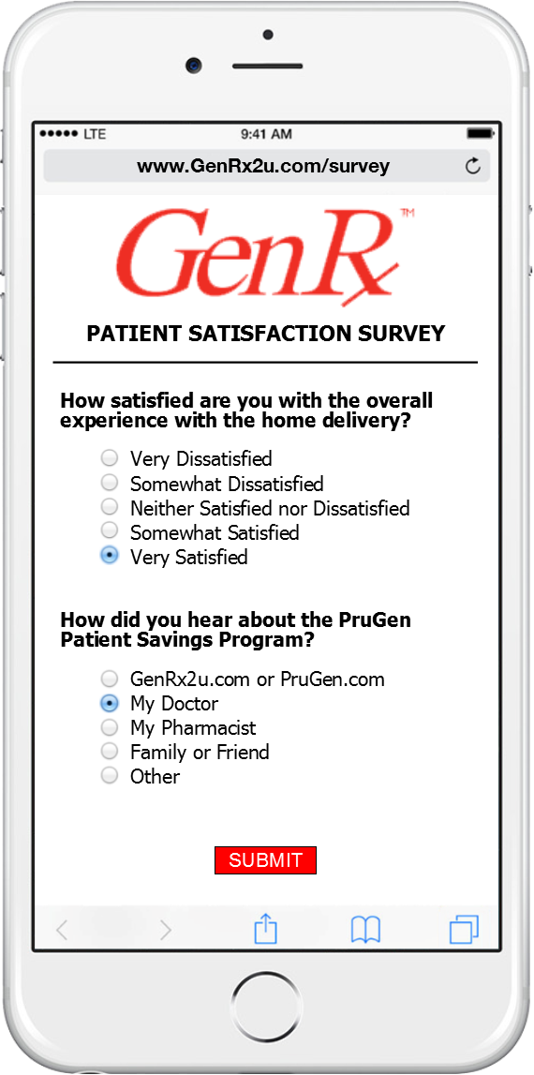
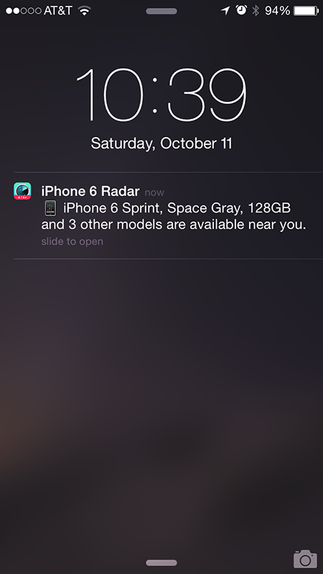

iOS
Lock Screen Notifications
MY ALERTS
ALL MESSAGES
3 CRITICAL
CRITICAL (3)
NEW (3)
READ (6)
UNREAD - RECEIVED 2h 3m ago
Alert : Re: Your Recent Transfer Request
Requires your immediate attention
YOUR RX IS OUT OF REFILLS: OMEPRA..
UNREAD - RECEIVED 2h 17m ago
Alert : Your Payment Method on file Requires your Immediate Attention
INSURANCE CARD OUT OF DATE
UNREAD - RECEIVED 1d ago
PAYMENT METHOD IS NOT VALID
Alert : Your Rx has 0 refills remaining
We are following up with the Prescriber
Alert : Your Rx has expired
We are following up with the Original Prescriber
Alert : Your Rx Insurance Card is not accepted
Cash price = $8.98 – shall we proceed?
© 2016. Prepared for internal use only. This document contains information proprietary and confidential to Ingenious Mobility and is not to be disclosed in whole or in part without the express written consent of IMV.

Slide 125
MY ALERTS
TRANSFER REQUEST
RX-DIRECT
H O M E D E L I V E R Y
ALERTS
CRITICAL: YOUR RECENT TRANSFER REQUEST
2 of 9 (3 new)
<< PREVIOUS NEXT >>
RECEIVED 2h 3m ago (4:16pm 10/13/2015)
Request made: Mon OCT 15 @ 3:55 PM CST
SERVICE: TRANSFER
APPLICABLE DRUG: METHYLPHENIDATE 10MG
for OMEPRAZOLE 40MG is out of refills
MESSAGE:
Our records indicate it is time to order a refill for your OMEPRAZOLE 40MG, but there are no more refills remaining on this prescription. The good news is that we will call your prescriber on your behalf to request a new prescription. We will keep you informed of our progress on the My Alerts page.
MARK READ / RETURN TO LIST
© 2016. Prepared for internal use only. This document contains information proprietary and confidential to Ingenious Mobility and is not to be disclosed in whole or in part without the express written consent of IMV.

Slide 126
MY ALERTS
Rx Out of Refills
UPDATED 1/26
RX-DIRECT
H O M E D E L I V E R Y
MY ALERTS
OMEPRAZOLE OUT OF REFILLS
2 of 9 (3 new)
<< PREVIOUS NEXT >>
RECEIVED 2h 3m ago (4:16pm 01/13/2015)
SUBJECT:
Your prescription for OMEPRAZOLE 40MG is out of refills
MESSAGE:
Our records indicate it is time to order a refill for your OMEPRAZOLE 40MG, but there are no more refills remaining on this prescription. The good news is that we will call your prescriber on your behalf to request a new prescription. We will keep you informed of our progress on the My Alerts page.
MARK READ / RETURN TO LIST
© 2016. Prepared for internal use only. This document contains information proprietary and confidential to Ingenious Mobility and is not to be disclosed in whole or in part without the express written consent of IMV.

Slide 127
iOS
Lock Screen Notifications
MY ALERTS
ALL MESSAGES
3 CRITICAL
CRITICAL (3)
NEW (3)
READ (6)
UNREAD - RECEIVED 2h 3m ago
Alert : Re: Your Recent Transfer Request
Requires your immediate attention
YOUR RX IS OUT OF REFILLS: OMEPRA..
UNREAD - RECEIVED 2h 17m ago
Alert : Your Payment Method on file Requires your Immediate Attention
INSURANCE CARD OUT OF DATE
UNREAD - RECEIVED 1d ago
PAYMENT METHOD IS NOT VALID
Alert : Your Rx has 0 refills remaining
We are following up with the Prescriber
Alert : Your Rx has expired
We are following up with the Original Prescriber
Alert : Your Rx Insurance Card is not accepted
Cash price = $8.98 – shall we proceed?
© 2016. Prepared for internal use only. This document contains information proprietary and confidential to Ingenious Mobility and is not to be disclosed in whole or in part without the express written consent of IMV.

Slide 128
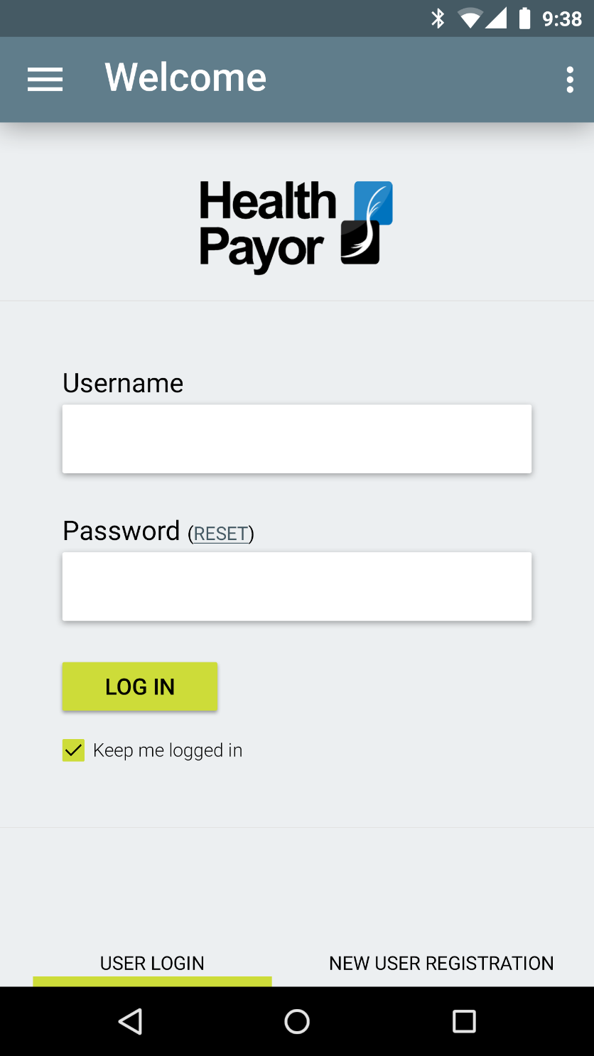
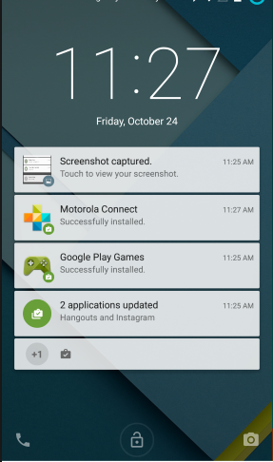

C-II v2
RX-DIRECT
H O M E D E L I V E R Y
MY ALERTS
ALL MESSAGES
3 CRITICAL
CRITICAL (3)
NEW (3)
READ (6)
UNREAD - RECEIVED 2h 3m ago
Alert : Re: Your Recent Transfer Request
Requires your immediate attention
YOUR RX IS OUT OF REFILLS: OMEPRA..
UNREAD - RECEIVED 2h 17m ago
INSURANCE CARD OUT OF DATE
UNREAD - RECEIVED 1d ago
PAYMENT METHOD IS NOT VALID
© 2016. Prepared for internal use only. This document contains information proprietary and confidential to Ingenious Mobility and is not to be disclosed in whole or in part without the express written consent of IMV.

Slide 129
Program Overview
Now you're ready to rock!
And let the savings roll in
By completing the registration process, you earned 350 Compliance Reward™ points!
Learn how to spend them.
350
Points Earned!
(+) Add Family Member
Medication Look Up
HOME
POINTS AWARDED SOUND?
TRANSFER A RX TO

Slide 130
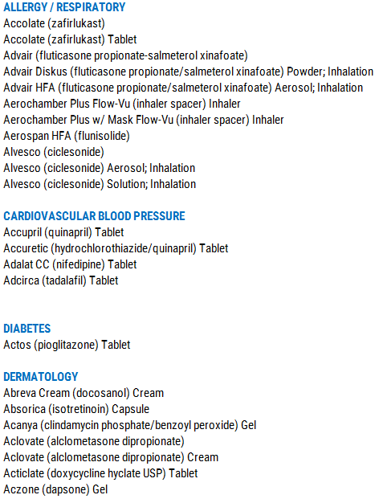
Brand Voucher LIST
RX-DIRECT
5
BRAND COPAY VOUCHER LIST
H O M E D E L I V E R Y
MAXIMUM SAVINGS POTENTIAL; PRESCRIPTION DRUG INSURANCE

Slide 131

Normal Set up
Rx INSURANCE
ENOUGH ABOUT US—
TELL US ABOUT YOU
- Name
- Allergies
- Delivery address
Insurance Card
Payment info
LETS GO
© 2016. Prepared for internal use only. This document contains information proprietary and confidential to Ingenious Mobility and is not to be disclosed in whole or in part without the express written consent of IMV.

Slide 132
COVERED RX LOOK UP
RX-DIRECT
PRICE LOOKUP
H O M E D E L I V E R Y
H O M E D E L I V E R Y
Propranolol
Pr
o
Prednisone
Pravastatin (Pravachol)
Propranolol
Promethazine
Propranolol
Promethazine
RX-DIRECT
10mg
20mg t
40mg
SELECT QUANITY
H O M E D E L I V E R Y
1
10
20
28
30
40
60
90
100
120
60 pills
PROPRANOLOL 20MG
$ 9.44
REDEEMED COMPLIANCE REWARDS™ BALANCE
YOUR RX PRICE
$ 6.29
CHAIN PHARMACY PRICE ESTIMATES
Enter a custom qty
WALGREENS
$16.96
SET
Qty
CVS
$15.34
RITE AID
$14.99
KROGER
$14.68
WAL-MART
$14.19
REQUEST TRANSFER RX
© 2016. Prepared for internal use only. This document contains information proprietary and confidential to Ingenious Mobility and is not to be disclosed in whole or in part without the express written consent of IMV.

Slide 133

PHARMACY LABEL
SILVER
306 E. RANDOL MILL ARLINGTON TX 76011
817-274-8200
306 E. RANDOL MILL ARLINGTON TX 76011
817-274-8200
Your Pharmacy Experience….Redefined
Your Pharmacy Experience….Redefined
REFILLS VIA OUR APP: RX-DIRECT.US
REFILLS VIA OUR APP: RX-DIRECT.US
Rx #
Rx #
00-3037565
REFILLS LEFT: 3
Until: 01-13-17
HOWARD T WILLIAMSON JR
01-13-16
For:
For:
MAY CAUSE DROWSINESS OR DIZZINESS
1711 W. WILMINGTON ST # 205 BETHESDA, TX 76096
TAKE WITH MEALS / FOOD
TAKE ONE TABLET BY MOUTH TWICE DAILY TO MANAGE CHOLESTEROL
MAY IMPAIR THE ABILITY TO OPERATE A VEHICLE, VESSEL, OR MACHINERY. USE CARE UNTIL YOU BECOME FAMILIAR WITH THE EFFECTS
DR. MARAKES, WILLIAM
ATORVASTATIN 20MG TAB
NDC: 68781-3656-25 PAR PHARMA
# 60
Generic for : LIPITOR
Discard After: 01-13-17
RPH: KEB/ TM
Caution: Federal Law Prohibits transfer of this drug to any person other than patient for whom prescribed
Caution: Federal Law Prohibits transfer of this drug to any person other than patient for whom prescribed
00-3037565
01-13-16 NEW RX ORIG: TRANSFER
WILLIAM MARAKES MD
HOWARD T WILLIAMSON JR
2509 OLD DENTON TAP STE 506
DENTON< TX 76250 (840)755-6365
NPI: 589568 DEA: BM5689898 DPS: Y012569
(M) DOB: 11-26-1978
1711 W. WILMINGTON ST # 205 BETHESDA, TX 76096 (702) 646-8965
REF ING COST: $ 4.96
Original 01-13-16 LAST; 01-13-16 QTY WRITTEN: 120
INS AMT PAID: $ 124.36
ATORVASTATIN 20MG TAB DISP #60 DS: 30
DISP FEE PAID: $ 0.96
PATIENT PAY: $ 24.36
TAKE ONE TABLET BY MOUTH TWICE DAILY TO MANAGE CHOLESTEROL
NET FEE: $ 118.51
NDC: 68781-3656-25 PAR PHARMA
RPH: KEB/ TM
AUTH: : XSHDHH22 EXPRES SCRPT
HOWARD T WILLIAMSON JR
1711 W. WILMINGTON ST
# 205
BETHESDA, TX 76096
© 2016. Prepared for internal use only. This document contains information proprietary and confidential to Ingenious Mobility and is not to be disclosed in whole or in part without the express written consent of IMV.
Height
Weight
BMI
PAGE << 1 of 1 >>
6 Ft 1 inch
215 LBS
20.2 %
Rx INSURANCE CARD RELATIONSHIP
Other Rx INSURANCE CARD
PAYMENT CARD
CYY Code
VISA ending in 1028
Expiration
03 - 17
* * *

Slide 134
COPAY ASSISTANCE FOR INSURED PATIENTS
RX-DIRECT
5
PRICE LOOKUP
H O M E D E L I V E R Y
CASH PAY PRICES
HOME DELIVERY vs LOCAL PICK-UP
Propran
EXCLUDE FROM PRICE TABLE:
CONTROLLED DRUGS– NOT TO BE PRICED-- “ NOT AVAILABLE IN PROGRAM”
OTC’S
EXCLUDED DOSAGE FORMS---------------------------------------
LIQUIDS, SYRUP, SOLUTIONS, SUSPENSIONS, EMULSIONS, VIALS , VACCINE, SYRINGE
AMPULES, IV, INJECTIONS, PRESSURIZED SPRAYS, FOAM, NEBULIZER SOLUTIONS, INHALERS, TOPICAL SOLUTIONS,
PATCHES, POWDERS, PACKETS, LOTIONS, SHAMPOO, BALMS, LOZENGE, WASH,
RX-DIRECT
H O M E D E L I V E R Y
$ 3.69
ok:DOSAGE FORMS-----------------
TABLET, CAPSULE, CAPLET, GEL TAB, EYE DROP, CREAM, GEL, OINTMENT, UNIT DOSE, CHEWABLE, TEST STRIP, NASAL SPRAY, PREFILLED PEN
30 day supply
90 day supply
$ 5.69
+ $ 2.00 handling fee
PRICE LOGIC:
CASH PRICES: BRANDS: WAC + 6% PLUS $ 2.75 HANDLING FEE
© 2016. Prepared for internal use only. This document contains information proprietary and confidential to Ingenious Mobility and is not to be disclosed in whole or in part without the express written consent of IMV.

